Slide 1
AEELNRT
Notes:
.

Slide 2
AEELNRT
IF the above alphagram does NOT show numbered Scrabble tiles,
then make sure you are viewing your downloaded version in the PowerPoint app
Notes:
.

Slide 3




AEELNRT
Use PowerPoint or Keynote in FULL SCREEN “SLIDE SHOW” mode on your LAPTOP or DESKTOP for best results
When you see the “ESCAPE KEY” ICON check speaker notes for additional information by hitting the escape key
Notes:
.

Slide 4
AEELNRT
OF THE 3 GOOD “SIXES”
WHAT BINGO STEM CAN BE CREATED
FOR THIS ALPHAGRAM?
Notes:
.

Slide 5
AEELNRT
ETERNAL
THE OTHER GOOD WORDS ARE TELERAN AND ENTERAL
NEATER + L
Notes:
NEATER: “SLICK RV, RIGHT?”

Slide 6
ETERNAL
WHAT MNEMONIC PHRASE CAN WE ASSOCIATE WITH THIS BINGO STEM?
Notes:
.

Slide 7
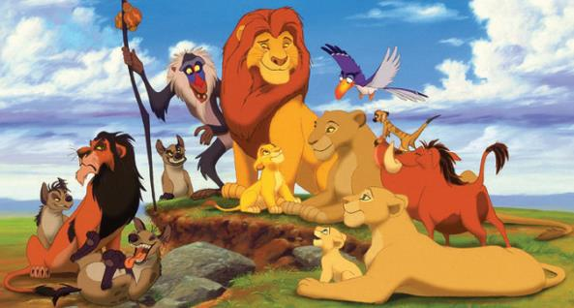

ETERNAL
WE SERVE HIM (REX) IN BEGINNING, END
REX
Notes:
ETERNAL: “WE SERVE HIM (REX) IN BEGINNING, END”
REX: 1. n. AN ANIMAL WITH A SINGLE WAVY LAYER OF HAIR (pl. REXES or REGES)
2. n. A KING (pl. REGES)
Shift + F5 to return to full screen

Slide 8
ETERNAL
W
AEELNRTW
ONE WORD
Notes:
.

Slide 9
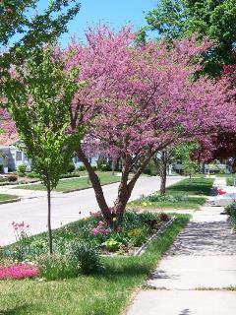
AEELNRTW
TREELAWN
S
TREELAWN: THE STRIP OF LAWN BETWEEN THE STREET AND THE SIDEWALK
Notes:
.

Slide 10
ETERNAL
E
AEEELNRT
ONE WORD
Notes:
.

Slide 11
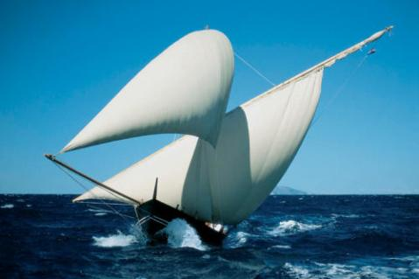
AEEELNRT
LATEENER
S
LATEENER: A SAILING VESSEL (also LATEEN/S)
Notes:
.

Slide 12
ETERNAL
S
AEELNRST
TWO WORDS
Notes:
.

Slide 13
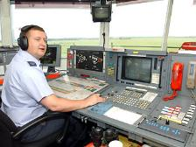
AEELNRST
_
ETERNALS
ETERNALS: pl. of n. ETERNAL, SOMETHING THAT LASTS FOREVER
_
TELERANS
TELERANS: pl. of TELERAN, A SYSTEM OF AIR NAVIGATION
THE SHIFT FOR AN AIR TRAFFIC CONTROLLER SEEMED LIKE ONE OF THE ETERNALS (ESPECIALLY IF HE HAD AN ENTERAL PROBLEM) USING TELERANS FOR 12 HOURS STRAIGHT.
EASTERN + L, STEALER + N, RENTALS + E, ETERNAL + S
Notes:
EASTERN: “BROUGHT JOVIAL FACES”
STEALER: RIPPED OFF TOY CHEST (FUN BOX)
RENTALS: “HAVING HUT SPACE”
ETERNAL: “WE SERVE HIM, REX, IN BEGINNING, END”

Slide 14
ETERNAL
R
AEELNRRT
ONE WORD
Notes:
.

Slide 15


AEELNRRT
_
RELEARNT
RELEARNT: RELEARNED (also LEARNT)
WE RELEARNT THAT rerental* IS NOT A GOOD WORD UNLESS HYPHENATED.
Notes:
.

Slide 16
ETERNAL
V
AEELNRTV
TWO WORDS
Notes:
.

Slide 17

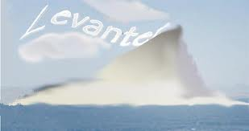
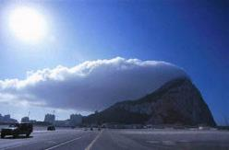

AEELNRTV
LEVANTER
RELEVANT
S
LEVANTER: AN EASTERLY MEDITERRANEAN WIND
WHEN DEFINING A LEVANTER, DIRECTION IS RELEVANT
Notes:
EASTERLY MEANS BLOWING FROM THE EAST.
LEVANT HAS A TOTALLY DIFFERENT MEANING, TO AVOID A DEBT (LEVANTS, LEVANTED, LEVANTING)
Shift + F5 to return to full screen

Slide 18
ETERNAL
H
AEEHLNRT
ONE WORD
Notes:
.

Slide 19

AEEHLNRT
LEATHERN
_
LEATHERN: adj. MADE OF LEATHER
Notes:
THERE IS A FRONT HOOK FOR LEATHER, BUT NOT FOR LEATHERN.
Shift + F5 to return to full screen.

Slide 20
ETERNAL
I
AEEILNRT
THERE ARE THREE!
Notes:
.

Slide 21
AEEILNRT
ELATERIN
ENTAILER
TREENAIL
S
ELATERIN: A CHEMICAL COMPOUND
S
ENTAILER: ONE WHO ENTAILS, OR RESTRICTS THE INHERITANCE OF TO A SPECIFIED LINE OF HEIRS
S
TREENAIL: A WOODEN PEG USED FOR FASTENING TIMBERS (also TRENAIL/S, TRUNNEL/S)
Notes:
.

Slide 22




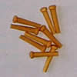
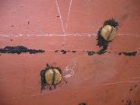
AEEILNRT
ELATERIN
ENTAILER
TREENAIL
TRAINEE + L ATELIER + N LINEATE + R LATRINE + E ETERNAL + I
Notes:
TRAINEE: “GIRL’S KID CHIMP”
ATELIER: “LOOK! POOLROOM FOR BOZOS FOND OF TV”
LINEATE: “GRAMP, DAD, LAD”
LATRINE: “CONFUSING, SEMIOPEN IN IVY”
ETERNAL: “WE SERVE HIM, REX, IN BEGINNING, END”

Slide 23
ETERNAL
M
AEELMNRT
ONE WORD
Notes:
.

Slide 24

AEELMNRT
LAMENTER
S
Notes:
.

Slide 25
ETERNAL
X
AEELNRTX
ONE WORD
Notes:
.

Slide 26
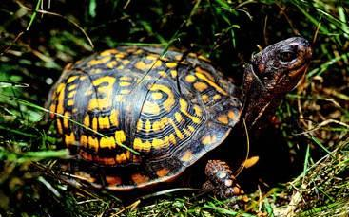
AEELNRTX
EXTERNAL
S
EXTERNAL: n. AN EXTERIOR
Notes:
.

Slide 27
ETERNAL
N
AEELNNRT
ONE WORD
Notes:
.

Slide 28
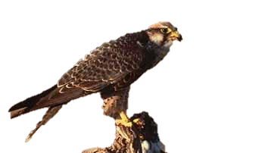
AEELNNRT
LANNERET
S
LANNERET: MALE LANNER, A FALCON OF EUROPE AND ASIA
Notes:
.

Slide 29
ETERNAL
B
ABEELNRT
ONE WORD
Notes:
.

Slide 30
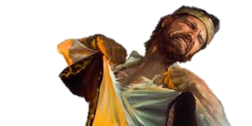
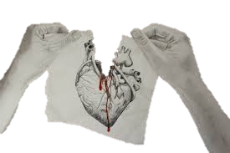
ABEELNRT
RENTABLE
RENTABLE: adj. CAPABLE OF BEING TORN APART FORCIBLY
Notes:
.

Slide 31
ETERNAL
G
AEEGLNRT
ONE WORD
Notes:
.

Slide 32
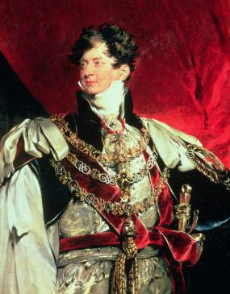
AEEGLNRT
REGENTAL
REGENTAL: adj. REFERRING TO A REGENT, ONE WHO RULES INSTEAD OF A SOVEREIGN
Notes:
.

Slide 33
ETERNAL
D
ADEELNRT
ONE WORD
Notes:
.

Slide 34
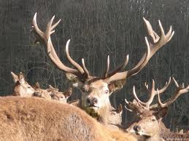
ADEELNRT
ANTLERED
ANTLERED IN TREE LAND
Notes:
.

Slide 35
ETERNAL
THAT’S IT! THE DIFFICULT BINGOS:
LATEENER REGENTAL
LEATHERN ELATERIN
LANNERET RELEARNT
TELERANS LEVANTER
Notes:
.

Slide 36
ETERNAL
WHAT WAS THAT MNEMONIC PHRASE?
Notes:
.

Slide 37
ETERNAL
WE SERVE HIM (REX) IN BEGINNING, END
REX
Notes:
ETERNAL: “WE SERVE HIM (REX) IN BEGINNING, END”

Slide 38
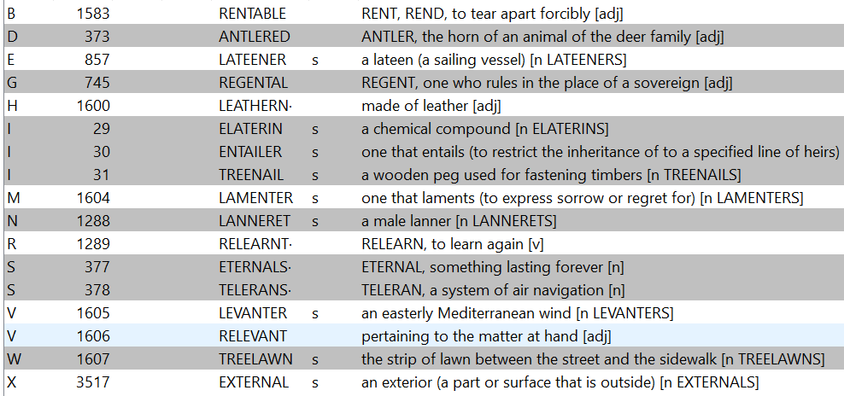
ETERNAL.
Notes:
.

Slide 39
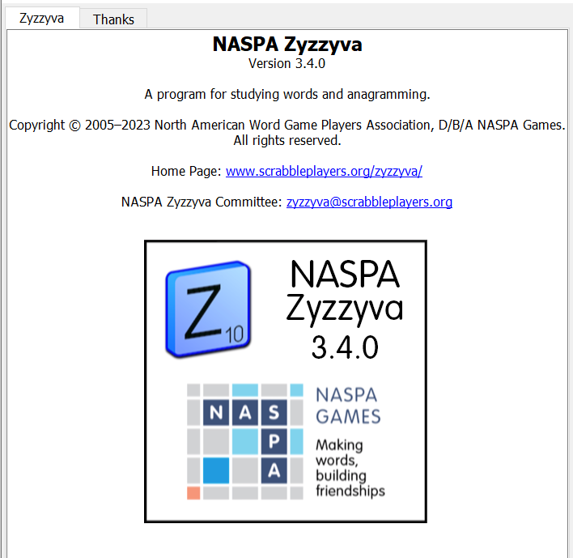

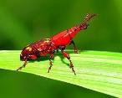
SEND suggestions or requests for additional PowerPoint slide shows to: williamrsnoddy@gmail.com
“Hey, Bill…”
Notes:
.

Slide 40

THE END!
Notes:
.

