Slide 1
AEIINRT
Nothing new from NWL23 or WOW24
Notes:
Nothing new from NWL23 or WOW24

Slide 2
AEIINRT
IF the above alphagram does NOT show numbered Scrabble tiles,
then make sure you are viewing your downloaded version in the PowerPoint app
Notes:
.

Slide 3




AEIINRT
Use PowerPoint or Keynote in FULL SCREEN “SLIDE SHOW” mode on your LAPTOP or DESKTOP for best results
When you see the “ESCAPE KEY” ICON check speaker notes for additional information by hitting the escape key
Notes:
.

Slide 4
AEIINRT
WHAT BINGO STEM
CAN BE CREATED
FROM THIS ALPHAGRAM?
Notes:
.

Slide 5
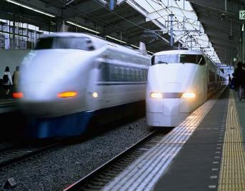

AEIINRT
INERTIA
OBJECTS WITH GREATER MASS HAVE MORE INERTIA.
RETINA + I TINIER + A
THERE ARE NO OTHER GOOD 7-LETTER WORDS
Notes:
RETINA: “THE RED PUPIL PREFERS MUCH WINKING”
TINIER: “MAN CHANGED A VW FLAT”

Slide 6
INERTIA
WHAT MNEMONIC PHRASE CAN WE ASSOCIATE WITH THIS BINGO STEM?
Notes:
.

Slide 7


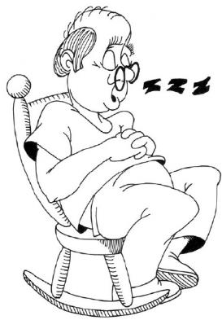


INERTIA
Z’S DEEPEN SLEEP
Notes:
INERTIA: “Z’S DEEPEN SLEEP”

Slide 8
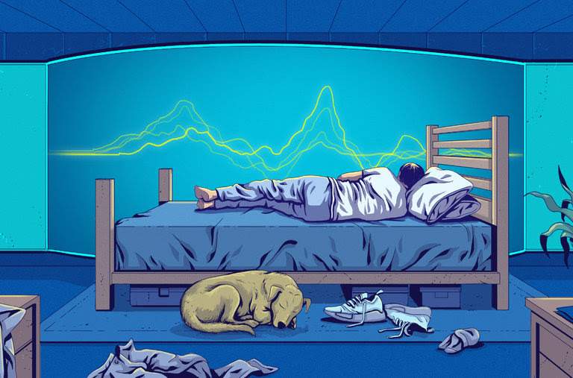

INERTIA
Z’S DEEPEN SLEEP
Notes:
INERTIA: “Z’S DEEPEN SLEEP”

Slide 9
INERTIA
Z
AEIINRTZ
ONE WORD
Notes:
.

Slide 10
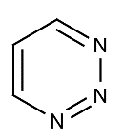
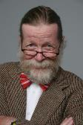
AEIINRTZ
_
TRIAZIN E
S
TRIAZINE: A CHEMICAL COMPOUND
(also TRIAZIN/S)
DESPITE Z INERTIA OF MY MIND, I RETAIN Z ANSWER: TRIAZINE
Notes:
.

Slide 11
INERTIA
S
AEIINRST
THERE ARE THREE!
Notes:
.

Slide 12


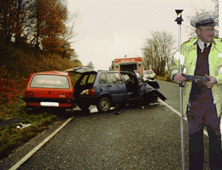
AEIINRST
INERTIAS
RAINIEST
SATINIER
_
B
G
SATINIER: MORE SATINY, LIKE SATIN (SATINIEST)
LAWS OF INERTIAS ARE INVOLVED WITH NASTIER ACCIDENTS ON THE RAINIEST OF DAYS, WHEN ROADS ARE SLICK AND ALMOST SATINIER.
HOOK/S?
BRAINIEST GRAINIEST
SIN-RITE + A NASTIER + I AIRIEST + N INERTIA + S
Notes:
SIN-RITE: “VAMP STABBED, SO HULK CAGED”
NASTIER: “WICKED HORRIBLE FANG STUMPS!”
AIRIEST: *ZaX iNHaLeS oPiuM aiRFLoW (*CoNSoNaNTS oNLY)
INERTIA: “Z’S DEEPEN SLEEP”

Slide 13
INERTIA
D
ADEIINRT
ONE WORD
Notes:
.

Slide 14
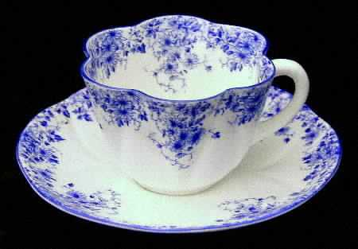
ADEIINRT
DAINTIER
DAINTIER: MORE DAINTY, DELICATELY PRETTY (DAINTIEST)
I TRAINED THE MAID TO PROTECT THE DAINTIER ITEMS.
DETRAIN + I INERTIA + D
Notes:
DETRAIN: “CHOO-CHOO STOPS, I GET OUT”
INERTIA: “Z’S DEEPEN SLEEP”

Slide 15
INERTIA
E
AEEIINRT
ONE WORD
Notes:
.

Slide 16

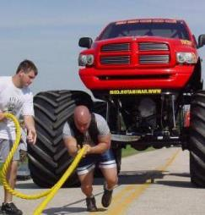
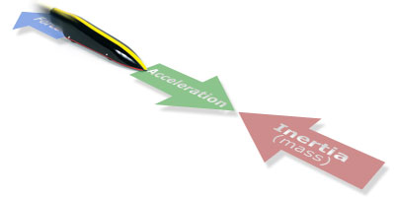
AEEIINRT
INERTIAE
_
INERTIAE: one of two plurals of INERTIA (also INERTIAS)
TRAINEE + I INERTIA + E
Notes:
TRAINEE: “GIRL’S KID CHIMP”
INERTIA: “Z’S DEEPEN SLEEP”

Slide 17
INERTIA
P
AEIINPRT
ONE WORD
Notes:
.

Slide 18
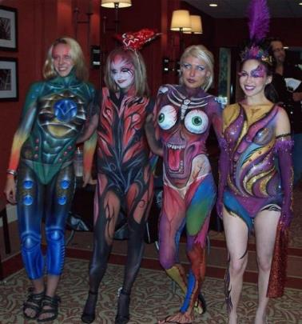
AEIINPRT
PAINTIER
PAINTIER: MORE COVERED WITH PAINT (PAINTY, PAINTIER, PAINTIEST)
I REPAINT UNTIL “PAINTIER”
PAINTER + I
INERTIA + P
Notes:
PAINTER: “GATHERED OILS”
INERTIA: “Z’S DEEPEN SLEEP”

Slide 19
INERTIA
N
AEIINNRT
ONE WORD
Notes:
.

Slide 20


AEIINNRT
TRIENNIA
L
TRIENNIA: one pl. of TRIENNIUM, A PERIOD OF THREE YEARS (also TRIENNIUMS)
3
l
HOOK/S?
SURELY NOT!
TRIENNIAL
Notes:
BIENNIA is also good! Plural of BIENNIUM (ALSO BIENNIUMS, adj. BIENNIAL)
QUADRENNIUM/S & QUADRENNIA/L, QUINQUENNIUM/S & QUINQUENNIA/L, DECENNIUM/S & DECENNIA/L, MILLENNIUM/S & MILLENNIA/L
Shift + F5 to return to full screen

Slide 21
INERTIA
L
AEIILNRT
ONE WORD
Notes:
.

Slide 22
AEIILNRT
INERTIAL
_
INERTIAL: adj. RELATING TO INERTIA
LATRINE + I INERTIA + L
Notes:
LATRINE: “CONFUSING, SEMIOPEN IN IVY”
INERTIA: “Z’S DEEPEN SLEEP”

Slide 23
INERTIA
THAT’S IT! BINGOS WORTH REVIEW:
INERTIAE
TRIENNIA
PAINTIER
TRIAZINE
SATINIER
Notes:
.

Slide 24
INERTIA
WHAT WAS THAT MNEMONIC PHRASE?
Notes:
.

Slide 25
INERTIA
Z’S DEEPEN SLEEP
Notes:
INERTIA: Z’S DEEPEN SLEEP

Slide 26

INERTIA
Z’S DEEPEN SLEEP
Notes:
INERTIA: “Z’S DEEPEN SLEEP”

Slide 27
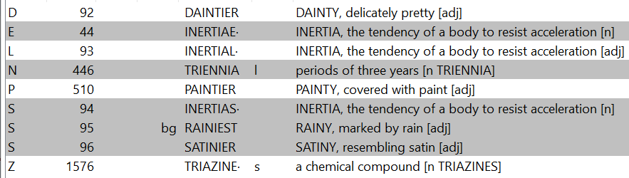
INERTIA?
Notes:
.

Slide 28
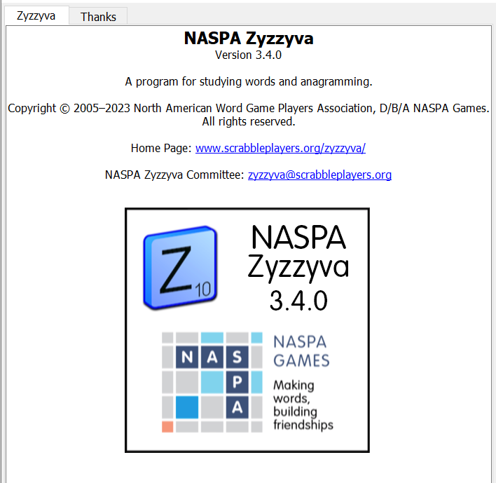

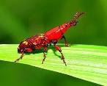
SEND suggestions or requests for additional PowerPoint slide shows to: williamrsnoddy@gmail.com
“Hey, Bill…”
Notes:
.

Slide 29


THE END!
INERTIA
Z’S DEEPEN SLEEP
Notes:
.

