Slide 1
EIMRST
Notes:
Nothing new from NWL23 or WOW24

Slide 2
EIMRST
IF the above alphagram does NOT show numbered Scrabble tiles,
then make sure you are viewing your downloaded version in the PowerPoint app
Notes:
.

Slide 3
EIMRST
Use PowerPoint or Keynote in FULL SCREEN “SLIDE SHOW” mode on your LAPTOP or DESKTOP for best results
When you see the “ESCAPE KEY” ICON check speaker notes for additional information by hitting the escape key
Notes:
.

Slide 4
EIMRST
OF THE 7 GOOD “SIXES”
WHAT BINGO STEM
SHOULD WE USE
FOR THIS ALPHAGRAM?
Notes:
.

Slide 5
EIMRST
MISTER
OTHER GOOD WORDS ARE MERITS, MITERS, MITRES, SMITER, TIMERS, AND REMITS.
Notes:
.

Slide 6
MISTER
WHAT MNEMONIC PHRASE CAN WE ASSOCIATE WITH THIS BINGO STEM?
Notes:
.

Slide 7
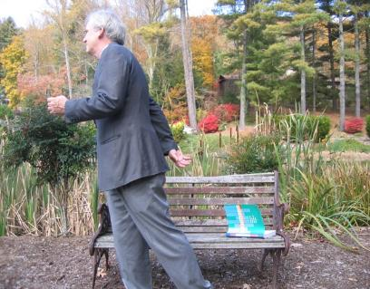
MISTER
MISTER LEFT BOOK OUT ON PARK BENCH
Notes:
MISTER: “MISTER LEFT BOOK OUT ON PARK BENCH”

Slide 8
MISTER M
EIMMRST
ONE WORD
Notes:
.

Slide 9
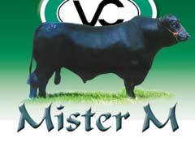
EIMMRST
MISTERM
_
S
MISTERM: TO CALL BY A WRONG NAME (MISTERMS, MISTERMED, MISTERMING)
TO CALL “MISTER M” A “COW” WOULD DEFINITELY BE A MISTERM.
Notes:
.

Slide 10
MISTER I
EIIMRST
THREE WORDS
Notes:
.

Slide 11
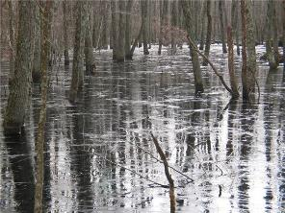
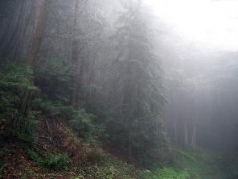
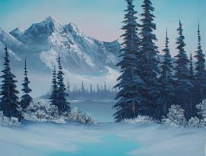
EIIMRST
MIRIEST
MISTIER
RIMIEST
MIRIEST: MOST MIRY, SWAMPIEST (MIRIER)
MISTIER: MORE MISTY (MISTIEST)
G
HOOK/S?
GRIMIEST
RIMIEST: MOST RIMY, FROSTY (RIMIER)
9
Notes:
.

Slide 12
MISTER S
EIMRSST
TWO WORDS
Notes:
.

Slide 13
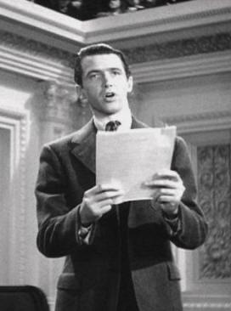
EIMRSST
MISTERS
SMITERS
_
_
_
ONE OF THE MISTERS WHO BECAME ONE OF THE SMITERS OF THE STATUS QUO* IN WASHINGTON
SISTER + M MISTER + S
Notes:
SISTER: “FEMALE, BUT DOESN’T EVOKE PANGS”
MISTER: “MISTER LEFT BOOK OUT ON PARK BENCH”

Slide 14
MISTER T
EIMRSTT
ONE WORD
Notes:
.

Slide 15
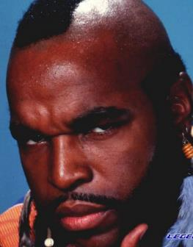
EIMRSTT
METRIST
S
METRIST: ONE WHO METRIFIES (COMPOSES IN METRICAL FORM)
MISTER T IS A METRIST?
Notes:
.

Slide 16
MISTER E
EEIMRST
FIVE WORDS
Notes:
.

Slide 17
EEIMRST
MEISTER
METIERS
REEMITS
RETIMES
TRISEME
S
METIERS: pl. of METIER, A VOCATION
_
_
RETIES + M REMISE + T MISTER + E
_
TRISEME: A TYPE OF METRICAL FOOT (adj. TRISEMIC)
S
MEISTER: ONE WHO IS KNOWLEDGEABLE ABOUT A SPECIFIED SUBJECT
Notes:
RETIES: “SHACKLED, MAZE PREVENTS ESCAPE”
REMISE: “CHAPS HANG TEXAS BADMAN”
MISTER: “MISTER LEFT BOOK OUT ON PARK BENCH”

Slide 18
MISTER R
EIMRRST
TWO WORDS
Notes:
.

Slide 19
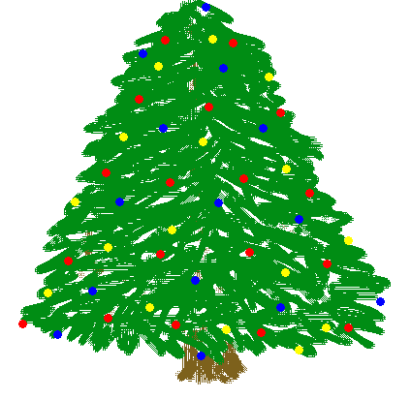
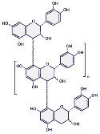
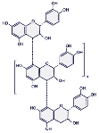
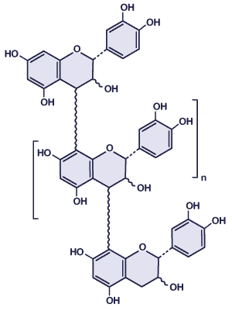
EIMRRST
_
P
RETRIMS
TRIMERS
_
_
TRIMERS: TYPES OF CHEMICAL COMPOUNDS
HOOK/S?
PRETRIMS
Notes:
.

Slide 20
MISTER L
EILMRST
ONE WORD
Notes:
.

Slide 21
EILMRST
MILTERS
_
MILTERS: pl. of MILTER, A MALE FISH AT BREEDING TIMES
LISTER + M MISTER + L
MILTY: adj. FULL OF MILT (MILTIER, MILTIEST)
MILT: n. THE SEMEN OF A FISH (MILTS)
MILT: v. TO FERTILIZE WITH MILT (MILTS, MILTED, MILTING)
Notes:
LISTER: “CHIEF JOB: MAKING UP LISTS”
MISTER: “MISTER LEFT BOOK OUT ON PARK BENCH”

Slide 22
MISTER F
EFIMRST
ONE WORD
Notes:
.

Slide 23
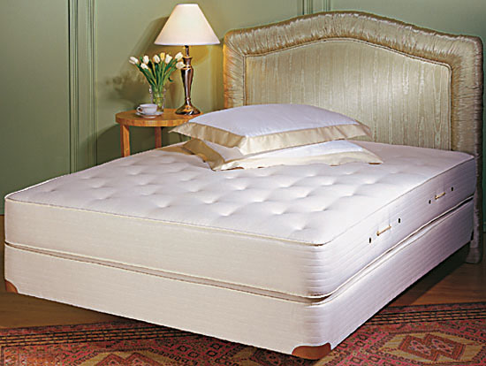
EFIMRST
FIRMEST
Notes:
.

Slide 24
MISTER B
BEIMRST
TWO WORDS
Notes:
.

Slide 25
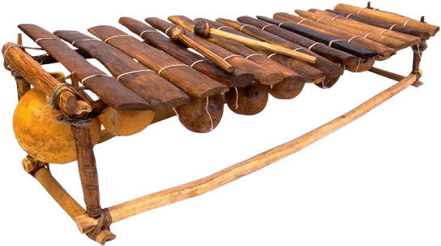
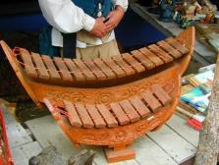
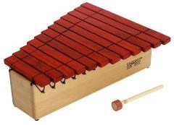
BEIMRST
_
TIMBERS
TIMBRES
_
TIMBRES: QUALITIES GIVEN TO A SOUND BY ITS OVERTONES
DIFFERENT TIMBERS, DIFFERENT TIMBRES
Notes:
.

Slide 26
MISTER O
EIMORST
FOUR WORDS
Notes:
.

Slide 27
EIMORST
EROTISM
MOISTER
MORTISE
TRISOME
MORTISE: v. TO JOIN OR FASTEN SECURELY (MORTISES, MORTISED, MORTISING & also v. MORTICE et al)
S
D
A
R
S
S
IF THE SITUATION INCLUDES EROTISM, MOISTER, AND MORTISE THEN I AM NOT ABOUT TO MAKE A SENTENCE INVOLVING A TRISOME.
YES, VIRGINIA, I COUNT SIX LEGS, TOO
AMORTISE MORTISED MORTISER
HOOK/S?
EROTISMS
TRISOMES
SORTIE + M MISTER + O
Notes:
SORTIE: “U.S. CHUMS DROP BOMBS ON GULF”
MISTER: “MISTER LEFT BOOK OUT ON PARK BENCH”

Slide 28
MISTER K
EIKMRST
ONE WORD
Notes:
.

Slide 29
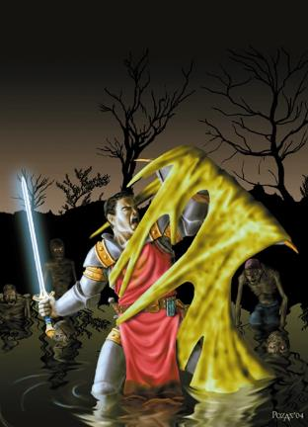
EIKMRST
MIRKEST
MIRKEST: adj. MOST MIRK OR DARK; MIRKY, MIRKER, MIRKIER, MIRKIEST; also MURK, MURKY, MURKER, MURKEST, MURKIER, MURKIEST (adv. MIRKILY, MURKLY, MURKILY)
Notes:
.

Slide 30
MISTER U
EIMRSTU
ONE WORD
Notes:
.

Slide 31
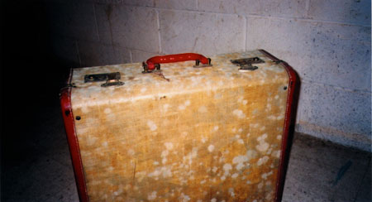
EIMRSTU
MUSTIER
SUITER + M MISTER + U
Notes:
SUITER: “GOOK FOOLS DOM QOPH (CONS BOSS) VROOM!”
MISTER: “MISTER LEFT BOOK OUT ON PARK BENCH”

Slide 32
MISTER N
EIMNRST
THREE WORDS
Notes:
.

Slide 33
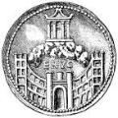
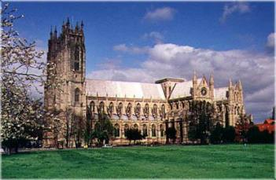
EIMNRST
MINSTER
MINTERS
REMINTS
MINSTER: A LARGE CHURCH
S
_
_
_
REGARDING THE COINS WITH THE MINSTER, THE MINTERS RECEIVED SUCH GOOD FEEDBACK THAT SEVERAL REMINTS WERE PLANNED.
INSERT + M MISTER + N
Notes:
INSERT: “DOPES WOULD LOVE TO MAKE A FEW CHANGES”
MISTER: “MISTER LEFT BOOK OUT ON PARK BENCH”

Slide 34
MISTER P
EIMPRST
TWO WORDS
Notes:
.

Slide 35
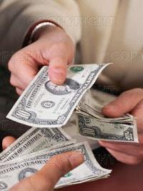
EIMPRST
IMPREST
PERMITS
S
_
IMPREST: A LOAN OR ADVANCE OF MONEY
HE PRESSED AN IMPREST OF SEVERAL BILLS INTO HIS SON’S HAND, WHICH PERMITS THE YOUNG MAN TO HAVE SOME FUN ON A SATURDAY NIGHT.
SPRITE + M MISTER + P
Notes:
SPRITE: “EVERY ADULT COMPLAINED OF THIRST”
MISTER: “MISTER LEFT BOOK OUT ON PARK BENCH”

Slide 36
MISTER A
AEIMRST
FOUR WORDS
Notes:
.

Slide 37
AEIMRST
IMARETS: pl. of IMARET, A TURKISH INN
_
IMARETS
MAESTRI
MISRATE
SMARTIE
MAESTRI: one pl. of MAESTRO, MASTERS OF AN ART (also pl. MAESTROS)
D
S
S
SMARTIE: AN OBNOXIOUSLY CONCEITED PERSON (alt. for SMARTY)
SATIRE + M MISTER + A {SMARTIE + ?}
HOOK/S?
MISRATED MISRATES SMARTIES
Notes:
SATIRE: “BAD SPEECH REVIEW, FLAMING WIT”
MISTER: “MISTER LEFT BOOK OUT ON PARK BENCH”
SMARTIE : “VALUES KNOWING, EXPECTS DUMBNESS”

Slide 38
MISTER C
CEIMRST
ONE WORD
Notes:
.

Slide 39
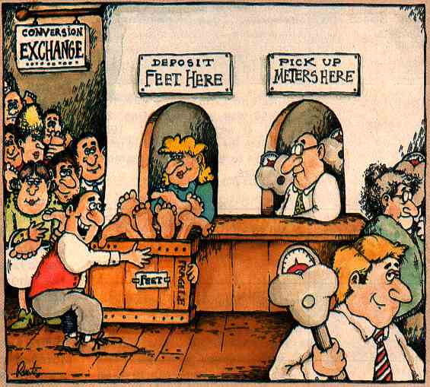
CEIMRST
METRICS
_
METRICS: pl. of n. METRIC, A STANDARD OF MEASUREMENT
METRICS CONVERSION
Notes:
.

Slide 40
MISTER H
EHIMRST
TWO WORDS
Notes:
.

Slide 41
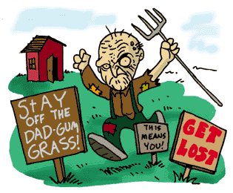
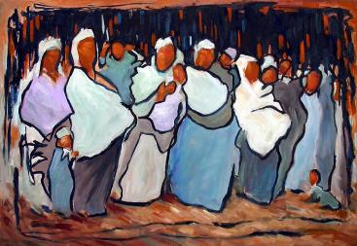
EHIMRST
_
HERMITS
MITHERS
T
S
_
MITHERS: pl. of MITHER, MOTHER
HOOK/S?
THERMITS AND SMITHERS
Notes:
SMITHERS HAS A STICKY S on the rear, and means “small fragments.”
Shift + F5 to return to full screen

Slide 42
MISTER
THAT’S IT! THE DIFFICULT BINGOS:
MIRIEST RIMIEST
TRISEME TRIMERS
TRISOME MIRKEST
MINSTER IMPREST
IMARETS MITHERS
MEISTER
Notes:
.

Slide 43
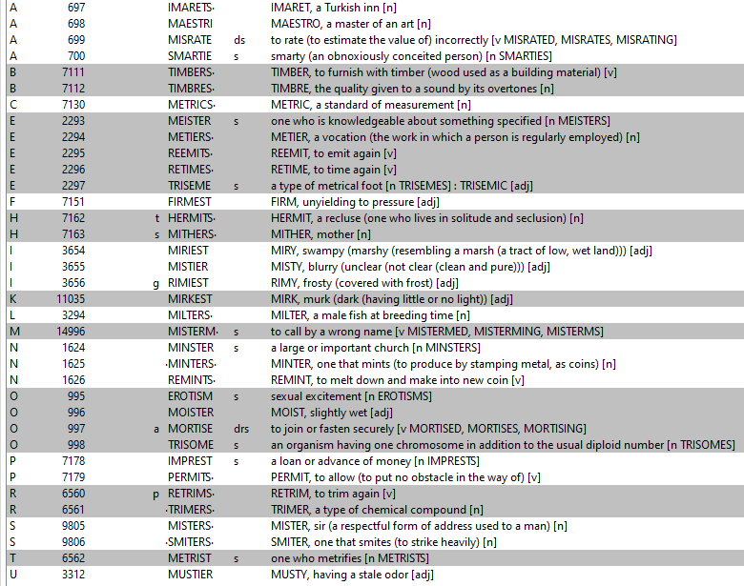
MISTER?
Notes:
.

Slide 44
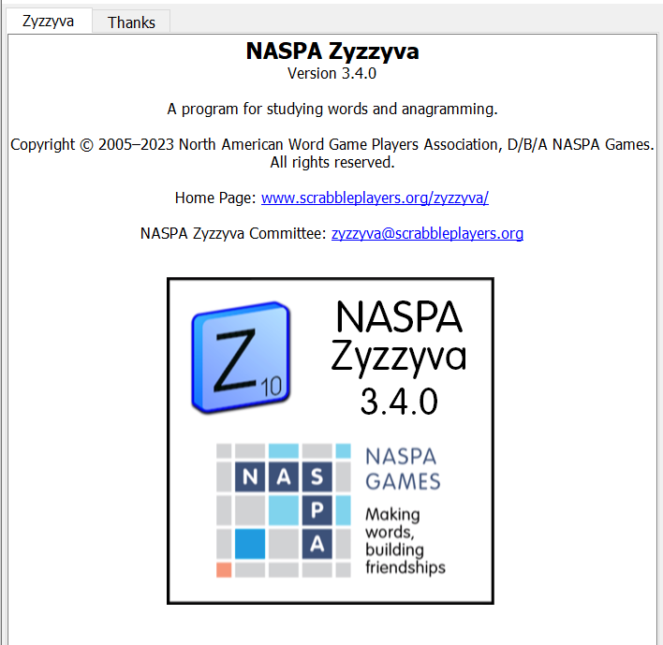
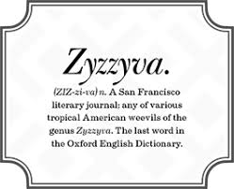
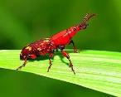
SEND suggestions or requests for additional PowerPoint slide shows to: williamrsnoddy@gmail.com
“Hey, Bill…”
Notes:
.

Slide 45
MISTER
WHAT WAS THAT MNEMONIC PHRASE?
Notes:
.

Slide 46
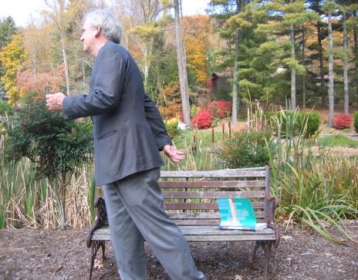
MISTER
MISTER LEFT BOOK OUT ON PARK BENCH
Notes:
.

Slide 47
THE END
Notes:
.

