Slide 1
GINORS
Notes:
the only difference between the NWL23 WORD LIST and the list from WGPO’S WOW24 LIST:
GROINS + G IS GRINGOS, GOOD IN WOW24.

Slide 2
GINORS
IF the above alphagram does NOT show numbered Scrabble tiles,
then make sure you are viewing your downloaded version in the PowerPoint app
Notes:
.

Slide 3
GINORS
Use PowerPoint or Keynote in FULL SCREEN “SLIDE SHOW” mode on your LAPTOP or DESKTOP for best results
When you see the “ESCAPE KEY” ICON check speaker notes for additional information by hitting the escape key
Notes:
.

Slide 4
GINORS
OF THE SIX POSSIBLE WORDS, WHICH WILL WE CHOOSE FOR A BINGO STEM?
Notes:
.

Slide 5
GINORS
GROINS
Notes:
.

Slide 6
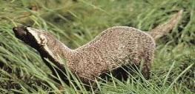
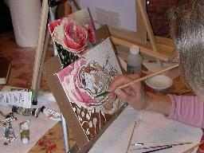
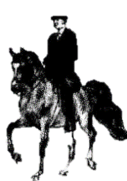
GROINS
GIRONS
GRISON
ROSING
SIGNOR
SORING
OTHER GOOD WORDS ARE: GIRONS (GYRONS, HERALDIC DESIGNS), GRISON (A CARNIVOROUS MAMMAL), ROSING (MAKING THE COLOR OF A ROSE), SIGNOR (ITALIAN TITLE OF COURTESY FOR A MAN), AND SORING (THE PRACTICE OF MAKING A HORSE’S FRONT FEET SORE TO PROMOTE HIGH-STEPPING.)

Slide 7
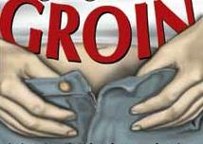
GROINS
WHAT MNEMONIC PHRASE
CAN WE ASSOCIATE
WITH THIS BINGO STEM?
S
Notes:
.

Slide 8
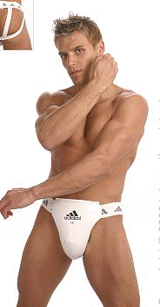
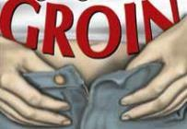
GROINS
THIS CHAP’S WAS THE BEST YOU’VE SEEN
S
Notes:
The “slur” gringos* no longer good in NWL23 after the NWL2020 expurgation, but GRINGO/S is good in WGPO’s WOW24 word list!
GROINS: “THIS CHAP’S WAS THE BEST YOU’VE SEEN”

Slide 9
GROINS T
GINORST
THERE ARE THREE!
Notes:
.

Slide 10
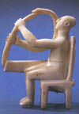
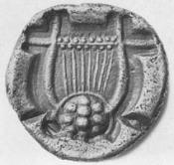
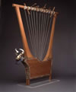
GINORST
SORTING
STORING
TRIGONS
S
THE CURATOR’S JOB: SORTING AND STORING THE TRIGONS.
_
ADD AN “S” TO GET A NEW “8” FROM OWL3 AND ITS ANAGRAM:
SORTINGS [ ]
RINGTOSS
INTROS + G GROINS + T
TRIGONS: ANCIENT ROMAN OR GREEK STRINGED INSTRUMENTS, TRIANGULAR LYRES OR HARPS.
Notes:
INTROS: “HUGGING PAL FACE TO FACE”
GROINS: “THIS CHAP’S WAS THE BEST YOU’VE SEEN”

Slide 11
GROINS H
GHINORS
THERE ARE TWO!
Notes:
.

Slide 12
GHINORS
HORSING
SHORING
HORSING: v. TO PROVIDE WITH A HORSE (HORSE, HORSED, HORSES, HORSING)
S
SHORING: n. A SYSTEM OF SUPPORTING TIMBERS
Also verb:
SHORE SHORES SHORED
SHORING
HOOK/S?
Notes:
.

Slide 13
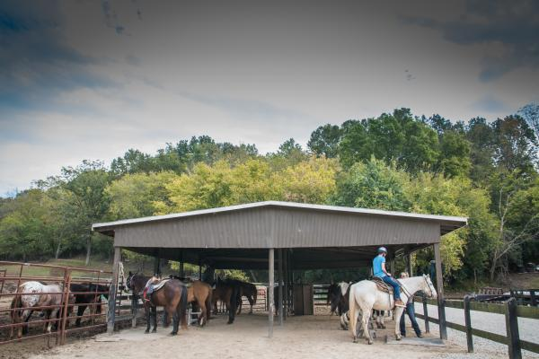
GHINORS
JUST FINE FOR HORSING (WITH OCCASIONAL UNHORSING) THIS STRUCTURE APPARENTLY HAS ADEQUATE SHORING.
Notes:
.

Slide 14
GROINS A
AGINORS
THERE ARE THREE!
Notes:
.

Slide 15
AGINORS
ORIGANS
SIGNORA
SOARING
_
ORIGANS: pl. of ORIGAN, A FRAGRANT HERB (also MARJORAM/S)
_
S
SIGNORA: AN ITALIAN TITLE OF COURTESY FOR A MARRIED WOMAN
_
S
SOARING: THE SPORT OF FLYING IN A POWERLESS AIRCRAFT
NORIAS + G GRAINS + O GROINS + A
Notes:
NORIAS: “FEW GET DEEP EFFECT”
GRAINS: “AVOID BACON, AND CHEAP HOMINY, TOO”
GROINS: “THIS CHAP’S WAS THE BEST YOU’VE SEEN”

Slide 16
AGINORS
ORIGANS
THE AROMA OF ORIGANS WAS PREFERRED BY THE SIGNORA WHILE SHE WAS SOARING.
Notes:
.

Slide 17
GROINS C
CGINORS
ONE WORD
Notes:
.

Slide 18
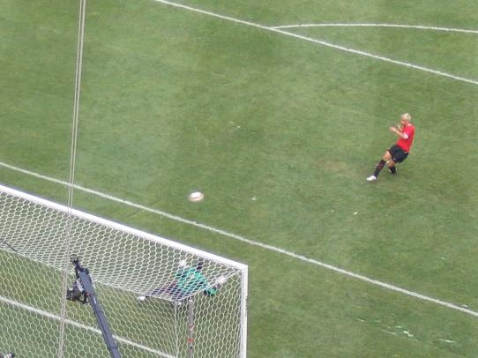
CGINORS
SCORING
_
S
SCORING TAKES AN S, BUT CORING DOES NOT.
Notes:
.

Slide 19
GROINS P
GINOPRS
THERE ARE THREE!
Notes:
.

Slide 20
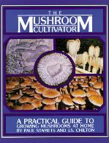
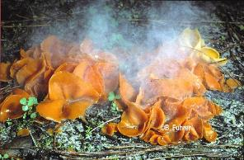
GINOPRS
PROSING: WRITING PROSE (PROSE, PROSES, PROSED, PROSING)
_
PROSING
ROPINGS
SPORING
_
ROPINGS: pl. of ROPING, THE ACT OF BINDING WITH A ROPE
_
SPORING: PRODUCING SPORES (SPORE, SPORES, SPORED, SPORING)
PROSING ABOUT SPORING, ROPINGS IS NEWISH.
Notes:
ROSING: v. TO MAKE THE COLOR OF A ROSE (ROSE, ROSES, ROSED)
PORING: v. GAZING INTENTLY (PORE, PORES, PORES)
Shift + F5 to return to full screen

Slide 21
GROINS S
GINORSS
THERE ARE THREE!
Notes:
.

Slide 22
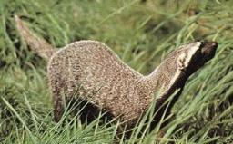
GINORSS
SIGNORS: one pl. of SIGNOR, AN ITALIAN MAN (also pl. SIGNORI)
_
GRISONS
SIGNORS
SORINGS
_
_
GRISONS: pl. of GRISON, CARNIVOROUS MAMMALS
SORINGS: pl. of SORING, THE PRACTICE OF MAKING HORSES’ FRONT FEET SORE TO PROMOTE HIGH-STEPPING
ADD A “T” TO GET A NEWISH “8” FROM OWL3 AND ITS ANAGRAM:
RINGTOSS
SORTINGS [ ]
Notes:
SIGNORS: USED AS COURTESY TITLES FOR MEN IN AN ITALIAN-SPEAKING AREA, EQUIVALENT TO MR.
SIGNOR, SIGNORS, SIGNORY, SIGNORE, SIGNORI, SIGNORIES, SIGNIOR, SIGNIORI, SIGNIORIES, SIGNIORS, SEIGNEUR, SEIGNIOR, SIGNIORY, SEIGNORY, SIGNORA, SIGNORAS. LET ME KNOW IF I MISSED ANY. SIGh.
Shift + F5 to return to full screen

Slide 23
GROINS W
GINORSW
ONE WORD
Notes:
.

Slide 24
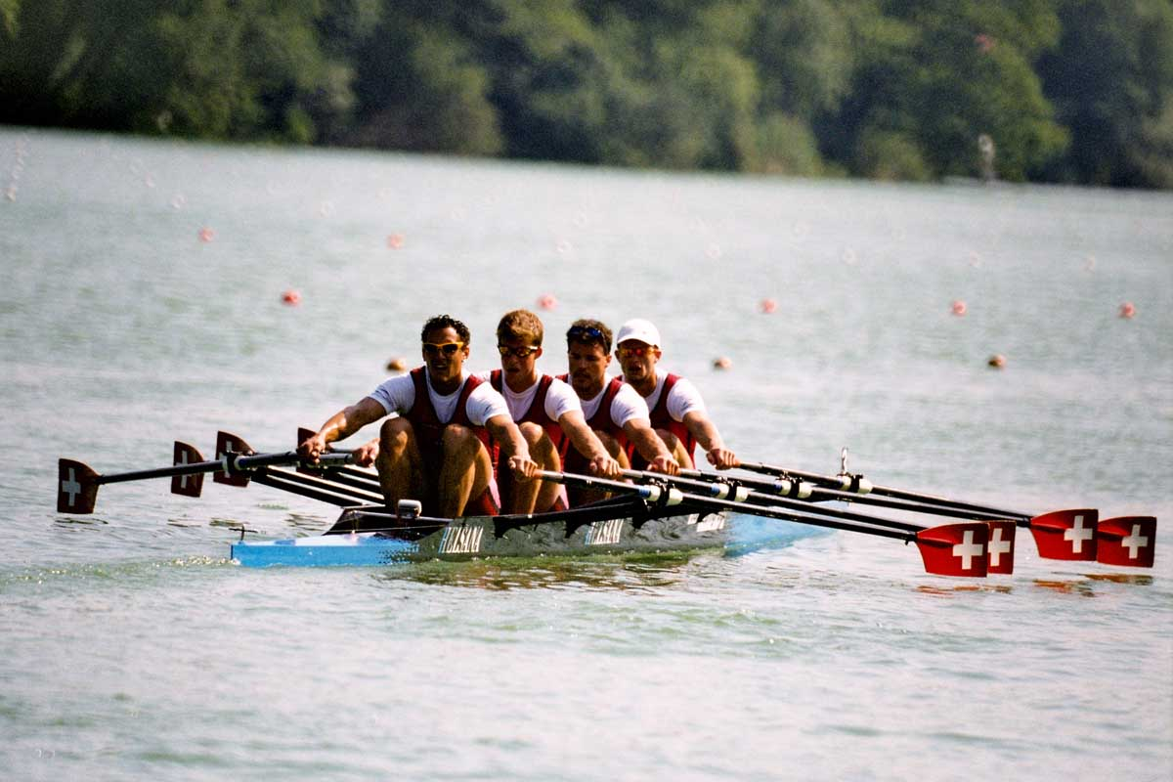
GINORSW
ROWINGS
_
Notes:
.

Slide 25
GROINS E
EGINORS
THERE ARE FOUR!
Notes:
.

Slide 26
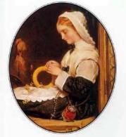
EGINORS
ERINGOS
IGNORES
REGIONS
SIGNORE
_
_
_
SIGNORE ARE MARRIED ITALIAN WOMEN.
_
_
ERINGO ERINGOS ERINGOES ERYNGO ERYNGOES ERYNGOS…ALL REFER TO A MEDICINAL HERB.
SELLING HER ERINGOS DOOR-TO-DOOR, SHE IGNORES THE FLIRTATIOUS MEN SO COMMON IN SOME REGIONS OF ITALY. AAH, THE PRETTIEST OF ALL THE SIGNORE.
SENIOR + G, SOIGNE + R, SINGER + O, ORGIES + N, GROINS + E {REGIONS +?}
Notes:
SENIOR: “OLD MVP JOGS WITH A CRUTCH”
SOIGNE: “A JEW WHEEZED, BELCHED PROUDLY”
SINGER: “WE LOVE THE CRAZY POP SOUND OF BOY GEORGE”
ORGIES: “MONTHLONG PORN”
GROINS: “THIS CHAP’S WAS THE BEST YOU’VE SEEN”
REGIONS: “BAD WINTRY PLACES”

Slide 27
GROINS B
BGINORS
THERE ARE TWO!
Notes:
.

Slide 28
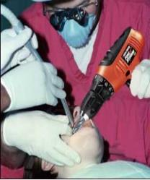
BGINORS
BORINGS: pl. of BORING, AN INNER CAVITY
BORINGS
SORBING
_
_
SORBING: v. TAKING UP AND HOLDING BY ABSORPTION OR ADSORPTION (SORB, SORBS, SORBED)
NOTE ANAGRAM FOR adj. SORBABLE:
[BELABORS]
WHEN DENTISTS ARE DEALING WITH BORINGS, GAUZE IS NEEDED FOR SORBING.
Notes:
.

Slide 29
GROINS I
GIINORS
THERE ARE THREE!
Notes:
.

Slide 30
GIINORS
_
ORIGINS
SIGNIOR
SIGNORI
I
S
Y
_
THERE ARE MANY WORDS WITH ITALIAN ORIGINS THAT ARE SIMILAR TO SIGNIOR AND SIGNORI.
SIGNOR, SIGNORS, SIGNORY, SIGNORE, SIGNORI, SIGNORIES, SIGNIOR, SIGNIORI, SIGNIORIES, SIGNIORS, SEIGNEUR, SEIGNIOR, SIGNIORY, SEIGNORY, SIGNORA, SIGNORAS. LET ME KNOW IF I MISSED ANY. SIGh.
HOOK/S?
SIGNIORI SIGNIORS SIGNIORY
Notes:
.

Slide 31
GROINS Y
GINORSY
ONE WORD
Notes:
.

Slide 32
GINORSY
SIGNORY
_
SIGNORY: SEIGNORY, SEIGNIORY, SEIGNEURY, MEANING POWER, RANK, OR ESTATE OF A SEIGNIOR, OR FEUDAL LORD (pl. SIGNORIES)
Notes:
.

Slide 33
GROINS O
GINOORS
ONE WORD
Notes:
.

Slide 34
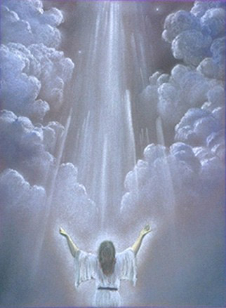
GINOORS
ROOSING
ROOSING: PRAISING
ROOSE ROOSED ROOSES plus noun ROOSER/S
Notes:
no front or back hooks for ROOSING, but with another tile you can make MOORINGS, ROOFINGS, ROOSTING, and SPOORING
Shift + F5 to return to full screen

Slide 35
GROINS U
GINORSU
THERE ARE TWO!
Notes:
.

Slide 36
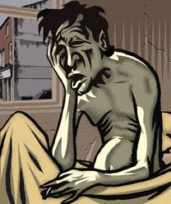
GINORSU
A
ROUSING
SOURING
G
HOOK/S?
AROUSING GROUSING
SOURING: MAKING OR BECOMING SOUR, MAKING OR BECOMING DISAGREEABLE, DISILLUSIONED, OR DISENCHANTED.
ROUSING SOMEONE FROM DEEP SLEEP WITHOUT SOURING THEIR DISPOSITION CAN BE A CHALLENGE.
Notes:
.

Slide 37
GROINS V
GINORSV
ONE WORD
Notes:
.

Slide 38
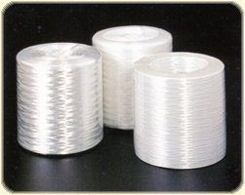
GINORSV
ROVINGS
D
_
ROVINGS: pl. of ROVING, A ROLL OF TEXTILE FIBERS
HOOK/S?
ADD “D” TO GET A NEW OWL3 “EIGHT”
DROVINGS
Notes:
.

Slide 39
GROINS N
GINNORS
THERE ARE TWO!
Notes:
.

Slide 40
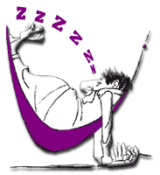
GINNORS
S
SNORING
SORNING
SORNING: FORCING ONESELF ON OTHERS FOR FOOD & LODGING (SORN, SORNS, SORNED, SORNING, SORNER/S)
HOOK/S?
SNORINGS?
FROM THE SOUND OF HIS SNORING, THE FRIEND WHO HAD BEEN SORNING FOR WEEKS WASN’T BOTHERED WHEN WE TOLD HIM HE HAD TO SLEEP IN A HAMMOCK!
Notes:
.

Slide 41
GROINS
THAT’S IT! THE DIFFICULT BINGOS:
ORIGANS SIGNORA
SORBING ROPINGS
SIGNORE SIGNIOR
SIGNORI SORNING
ROOSING SPORING
GRISONS SIGNORS
SORINGS PROSING
Notes:
.

Slide 42
GROINS
RELATIVELY NEW REAR S HOOKS FROM OWL3:
SCORINGS
SORTINGS
SNORINGS
Notes:
.

Slide 43
GROINS
WHAT WAS THAT MNEMONIC PHRASE?
Notes:
.

Slide 44
GROINS
THIS CHAP’S WAS THE BEST YOU’VE SEEN
S
Notes:
gringos* not good in NWL23 but GRINGO/S good in WGPO’s WOW24!
GROINS: “THIS CHAP’S WAS THE BEST YOU’VE SEEN”

Slide 45
GROINS
OR
If playing with WGPO’s WOW24 word list…
Notes:
.

Slide 46
GROINS
THIS CHAP’S WAS THE BIGGEST YOU’VE SEEN
S
Includes the G, because
in WOW24: GROINS + G =
Notes:
gringos* not good in NWL23 but GRINGO/S good in WGPO’s WOW24!
GROINS: “THIS CHAP’S WAS THE BEST YOU’VE SEEN”

Slide 47
GROINS G
GGINORS
ONE WORD
Notes:
.

Slide 48
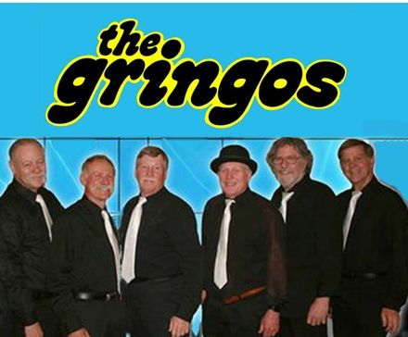
GINORSV
GRINGOS
_
GRINGOS: pl. of GRINGO, A PERSON WHO IS NOT HISPANIC OR LATINO
Notes:
.

Slide 49
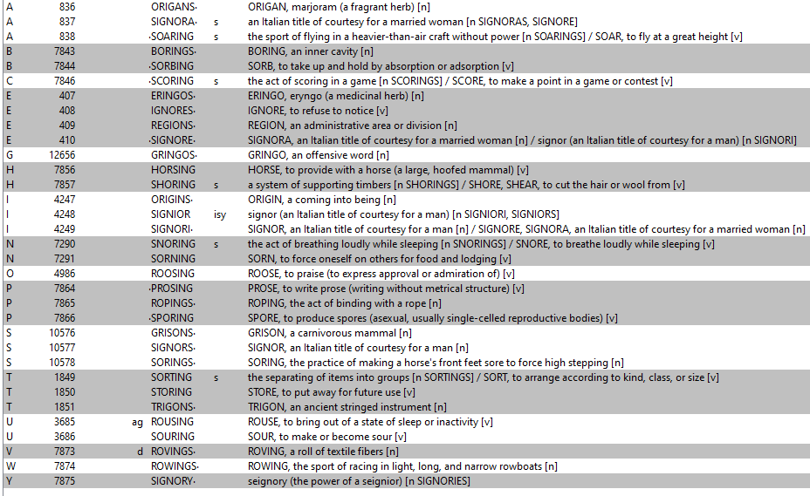
GROINS
gringos* not good in NWL23 but GRINGO/S good in WGPO’s WOW24!
Notes:
.

Slide 50
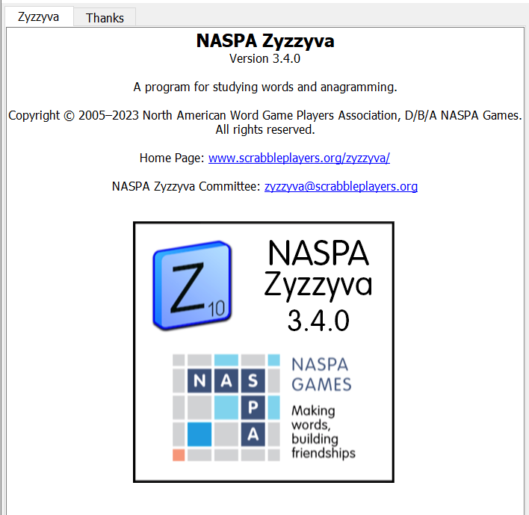
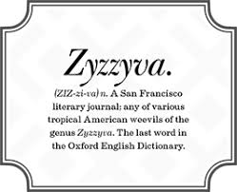
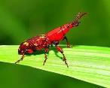
SEND suggestions or requests for additional PowerPoint slide shows to: williamrsnoddy@gmail.com
“Hey, Bill…”
Notes:
.

Slide 51
THE END
Notes:
.

