Slide 1
New Sixes from NWL 23
But this PowerPoint show reveals the 15 6-letter words excluded by the WGPO/WOW24 word list

Slide 2
SIXES
IF the above word does NOT show numbered Scrabble tiles,
then make sure you view your downloaded version in PowerPoint or KeyNote
Use PowerPoint or Keynote in FULL SCREEN “SLIDE SHOW” mode on your LAPTOP or DESKTOP for best results
When you see the “ESCAPE KEY” ICON check speaker notes for additional information by hitting the escape key

Slide 3
All the new TWL23 six-letter words with showing the WGPO/WOW deletions:
ADORBS ASSHAT ATTING BIRRIA BOHUNK BOUJEE BROIER BUBBAS BUCKRA CATHED CELLIE CHAGAS CHANNA CHEFFY CHICHA CHOLAS CHOLOS CHONKY CIDERY CONVOS COULDA COVIDS CRINGY CUCKED DEIXES DELEAF DOXING DOXXED DOXXES DUKKAH DUKKAS DURAGS EMPATH EMPING FANART FAVEST FIREES FRANCO FUTSAL GANKED GEOTAG GEPIKS GLAMPS GNETUM GOETTA GOYISH GREEKS HADEAN HANDSY HAOLES HOASCA HOGLET HOKKUS HOSSES HUCKED HUNDOS HUNKEY HUNKIE HYGGES IFTARS INCELS INNIES INSPOS INTELS IXNAYS JAMOKE JESUIT JOLLOF KANAKA KEYTAR KHARIF KIPPOT KRATOM LARPED LARPER LEAFER LIPOED LOCING LUESES MASKNE MATCHA MEETUP MIDDER MODDED MODDER MPOXES NATTOS NDUJAS NEONIC NEWSES NOOBIE NOOKIE ONESIE OTAKUS OUNCER OUTIES OXGALL PALEOS PEEPAL POMMIE PRONED PRONES PUNKED PWNING QUESOS RAMENS RANDOS REPOST RETCON ROUXES SALUME SALUMI SEXTED SHARTS SHIKSA SHIKSE SHIVED SILOES SKEEZY SPAZES SPORKS SWOLER THWAPS TYIYNS UNMUTE UNPAIR UNSUBS VACAYS VAXING VAXXED VAXXES VERBED VIBING WALIER WOULDA YEEHAW YEETED ZAATAR ZEDONK ZONKEY ZOODLE ZOOMER
However, the slide show will not look at new plurals and new verb tenses from the new threes, fours, and fives like DOXXES, CATHED, CHOLAS, etc.
So we will cover the following:
ADORBS ASSHAT BIRRIA BOHUNK BOUJEE BUCKRA CELLIE CHANNA CHEFFY CHICHA CHONKY CIDERY COULDA CRINGY DEIXES DELEAF DUKKAH DUKKAS EMPATH EMPING FANART FRANCO FUTSAL GEOTAG GNETUM GOETTA GOYISH GREEKS HADEAN HANDSY HOASCA HOGLET HOKKUS HUCKED HUNKEY HUNKIE IXNAYS JAMOKE JESUIT JOLLOF KANAKA KEYTAR KHARIF KIPPOT KRATOM LEAFER LIPOED LUESES MASKNE MATCHA MEETUP MIDDER MODDED MODDER NEONIC NEWSES NOOBIE NOOKIE ONESIE OTAKUS OUNCER OXGALL PALEOS PEEPAL POMMIE PRONED PRONES PUNKED RAMENS REPOST RETCON ROUXES SALUME SALUMI SEXTED SHIKSA SHIKSE SHIVED SILOES SKEEZY UNMUTE UNPAIR VERBED VIBING WALIER WOULDA YEEHAW ZAATAR ZEDONK ZONKEY ZOODLE ZOOMER

Slide 4
A B D O R S
FIVE WORDS

Slide 5
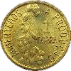
You could play
_
ADSORB
BOARDS
S
OR
_
_
_
BROADS
DOBRAS
DOBRAS: pl. of DOBRA, A PORTUGUESE GOLD COIN
But maybe you should play:
ADORBS
STICKY
ADORBS: adj. ADORABLE

Slide 6
A A H S S T
TWO WORDS

Slide 7
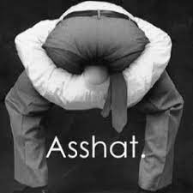
Why play
shasta
S
SHASTA: n. A FLOWERING PLANT
when you could play:
asshat
S
ASSHAT: A DETESTABLE PERSON

Slide 8
A B I I R R
ONE WORD

Slide 9
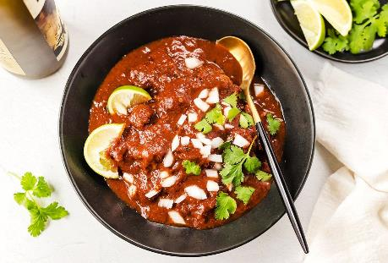
BIRRIA
S
BIRRIA: n. A MEXICAN BEEF STEW

Slide 10
B H K N O U
ONE WORD

Slide 11
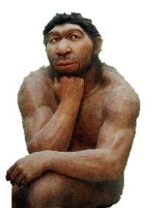
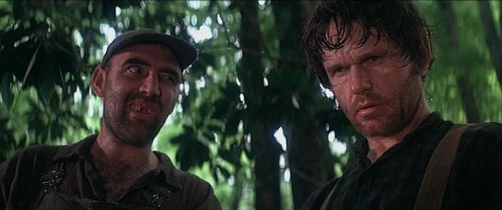
BOHUNK
S
BOHUNK: n. A ROUGH, STUPID PERSON

Slide 12
B E E J O U
ONE WORD

Slide 13
BOUJEE
BOUJEE: adj. OSTETATIOUS ABOUT RECENT WEALTH

Slide 14
A B C K R U
ONE WORD

Slide 15
BUCKRA
S
BUCKRA: n. BOSS

Slide 16
C E E I L L
ONE WORD

Slide 17
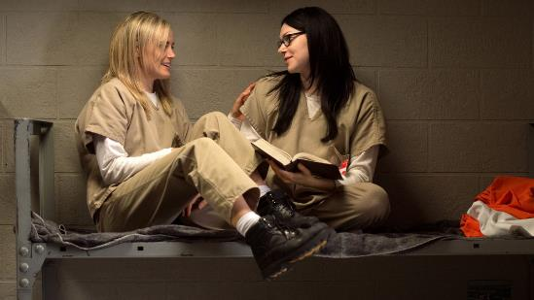
CELLIE
S
CELLIE: n. CELLMATE (also CELLY)

Slide 18
A A C H N N
ONE WORD

Slide 19
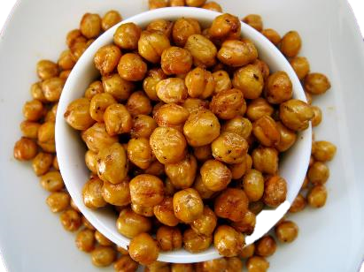
CHANNA
S
CHANNA: n. A SNACK OF CHICKPEAS

Slide 20
C E F F H Y
ONE WORD

Slide 21
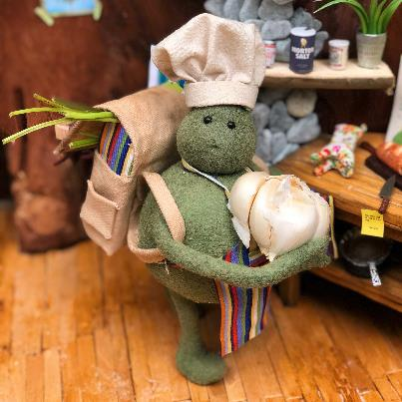
CHEFFY
CHEFFY: adj. RESEMBLING A CHEF (CHEFFIER, CHEFFIEST)

Slide 22
A C C H H I
ONE WORD

Slide 23
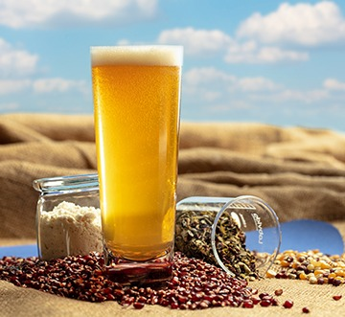
CHICHA
S
CHICHA: n. A LATIN AMERICAN CORN BEER

Slide 24
C H K N O Y
ONE WORD

Slide 25
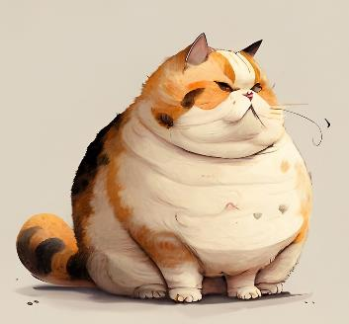
CHONKY
CHONKY: adj. ENDEARINGLY PLUMP

Slide 26
C D E I R Y
ONE WORD

Slide 27
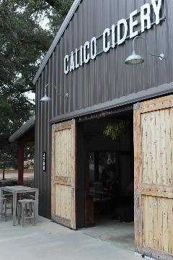
_
CIDERY
CIDERY 1. NWL23 adj. RESEMBLING CIDER (CIDERIER, CIDERIEST)
2. n. A PLACE WHERE CIDER IS MADE (pl. CIDERIES)

Slide 28
A C D L O U
ONE WORD

Slide 29
COULDA
_
COULDA: v. COULD HAVE
ALL THREE WORDS NOW GOOD IN SCRABBLE!

Slide 30
C G I N R Y
TWO WORDS

Slide 31
Why play
CRYING
S
when you could play:
CRINGY
CRINGEY: adj. EMBARRASSING (CRINGIER, CRINGIEST)
CRINGY: adj. AWKWARD

Slide 32
D E E I S X
TWO WORDS

Slide 33
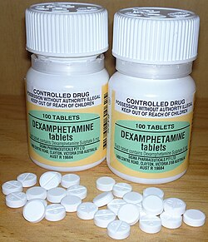
Why play
_
DEXIES
DEXIES: pl. of DEXY and DEXIE, A TABLET OF DEX
when you could play:
DEIXES
DEIXES: n. THE SPECIFYING FUNCTION OF SOME WORDS
(also DEIXIS, DEIXISES)

Slide 34
A d e e f l
THREE WORDS

Slide 35
You could play
DEFLEA
LEAFED
S
OR
But you could play:
DELEAF
S
DELEAFS: v. TO REMOVE LEAVES FROM
(DELEAF, DELEAFED, DELEAFING)

Slide 36
A D H K K U
ONE WORD

Slide 37
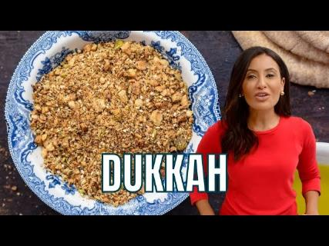
_
DUKKAH
S
DUKKAH: n. AN EGYPTIAN CONDIMENT

Slide 38
A E H M P T
ONE WORD

Slide 39
S
EMPATH
Y
EMPATH: n. ONE WHO HAS EMPATHY

Slide 40
E G I M N P
ONE WORD

Slide 41
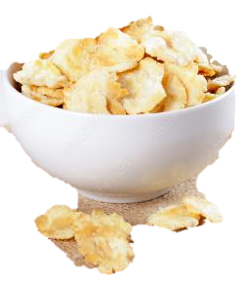
EMPING
T
S
EMPING: n. AN INDONESIAN SNACK CHIP
TEMPING: v. TO WORK AS A TEMPORARY EMPLOYEE

Slide 42
A A F N R T
ONE WORD

Slide 43
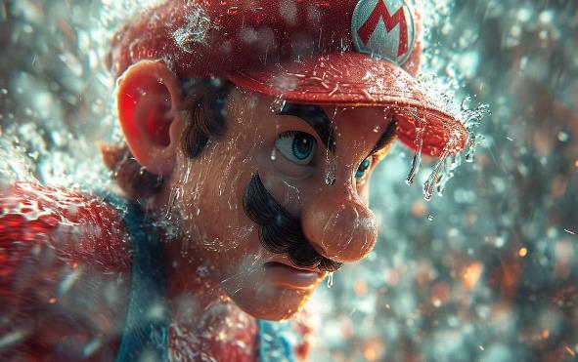
FANART
S
FANART: n. A PIECE OF ART CREATED BY A FAN

Slide 44
A C F N O R
ONE WORD

Slide 45
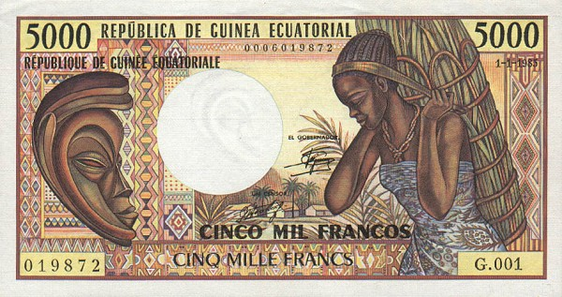
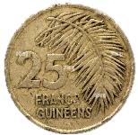
FRANCO
S
FRANCO: n. A FRANC IN EQUATORIAL GUINEA

Slide 46
A F L S T U
THREE WORDS

Slide 47
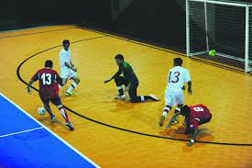
You could play
_
FLATUS
FAULTS
OR
But you could play:
FUTSAL
S
FUTSAL: n. AN INDOOR GAME BASED ON SOCCER

Slide 48
A E G G O T
ONE WORD

Slide 49
GEOTAG
S
GEOTAG: v. TO ADD GEOGRAPHIC METADATA TO A FILE
(GEOTAGGED, GEOTAGGING)

Slide 50
G E M N T U
TWO WORDS

Slide 51
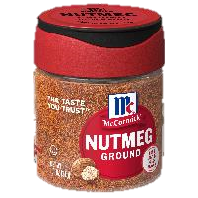
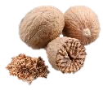
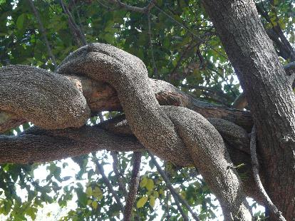
Why play
NUTMEG
S
NUTMEG: n. AN AROMATIC SEED USED AS A SPICE (adj. NUTMEGGY)
when you could play:
GNETUM
S
GNETUM: n. A TROPICAL TREE
(WOW24 won’t accept the rear –S)

Slide 52
A G E O T T
TWO WORDS

Slide 53
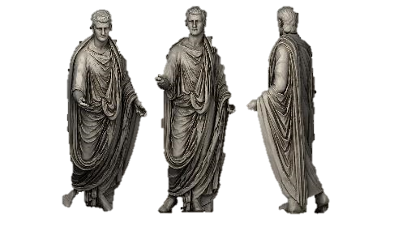
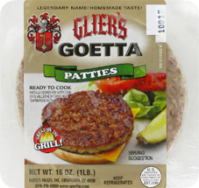
Why play
TOGATE
TOGATE: adj. PERTAINING TO ANCIENT ROME
when you could play:
GOETTA
S
GOETTA: n. A TYPE OF SAUSAGE POPULAR IN CINCINNATI
(WOW24 won’t accept the rear –S)

Slide 54
G H I O S Y
ONE WORD

Slide 55
GOYISH
E
GOYISH: adj. PERTAINING TO NON-JEWISH PERSONS
E
GOYISHE: adj. PERTAINING TO NON-JEWISH PERSONS

Slide 56
E E G K R S
ONE WORD

Slide 57
_
GREEKS
GREEKS: NWL23 pl. of GREEK, SOMETHING UNINTELLIGIBLE

Slide 58
A A D E H N
ONE WORD

Slide 59
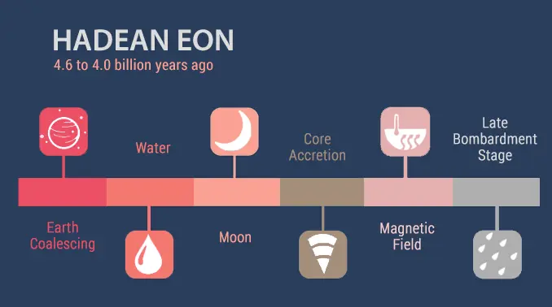
HADEAN
HADEAN: NWL23 adj. PERTAINING TO A GEOLOGICAL EON

Slide 60
A D H N S Y
TWO WORDS

Slide 61
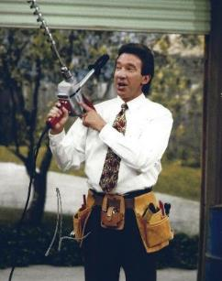
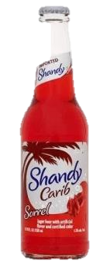
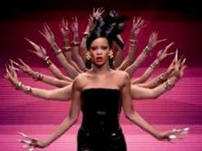
Why play
_
SHANDY
SHANDY: n. AN ALCOHOLIC DRINK
(pl. SHANDIES)
when you could play:
_
HANDSY
HANDSY: adj. USING HANDS AGRESSIVELY OR UNUSUALLY
(HANDSIER, HANDSIEST)

Slide 62
A A C H O S
ONE WORD

Slide 63
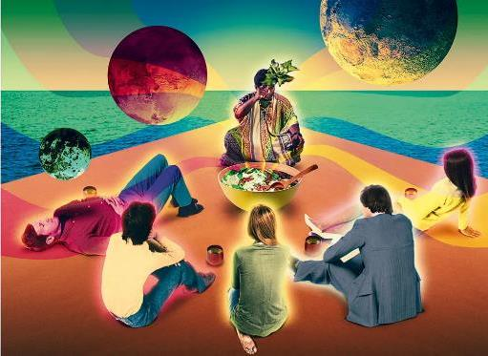
HOASCA
S
HOASCA: n. A HALLUCINOGENIC BREW FROM A SOUTH AMERICAN VINE (AYAHUASCA/S)

Slide 64
E G H L O T
ONE WORD

Slide 65
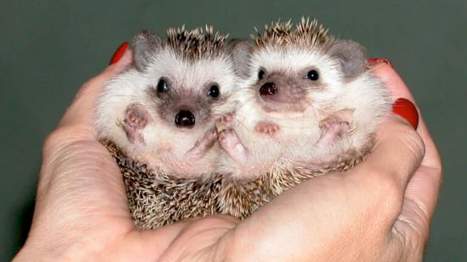
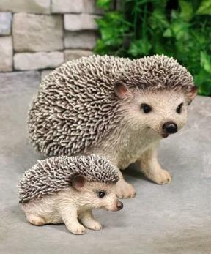
HOGLET
S
HOGLET: n. A BABY HEDGEHOG

Slide 66
H K K O S U
ONE WORD

Slide 67
HOKKUS
_
HOKKUS: NWL23 pl. of HOKKU, A JAPANESE POEM (also HAIKU/S)
Interesting: both NWL23 and WOW24 agree that HAIKU takes the S plural

Slide 68
C D E H K U
ONE WORD

Slide 69
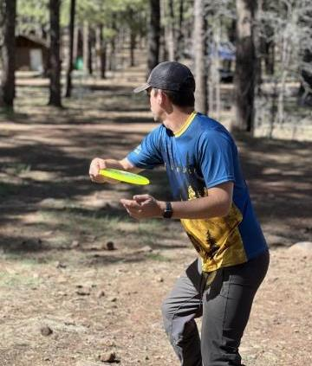
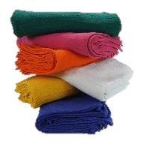
C
HUCKED
S
HUCKED: v. THREW (HUCK, HUCKS, HUCKING)
HUCK: n. A DURABLE FABRIC (HUCKS)

Slide 70
E H K N U Y
ONE WORD

Slide 71
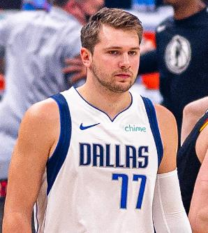
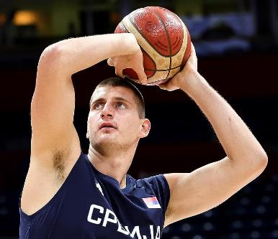
HUNKEY
S
HUNKEY: n. A PERSON OF HUNGARIAN OR SLAVIC DESCENT

Slide 72
E H I K N U
ONE WORD

Slide 73
RS
HUNKIE
HUNKIE: n. A PERSON OF HUNGARIAN OR SLAVIC DESCENT
HUNKY, HUNKIER, HUNKIEST

Slide 74
E G G H S Y
ONE WORD

Slide 75
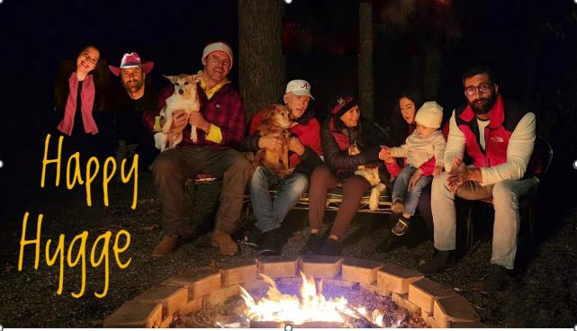
_
HYGGES
HYGGES: NWL23 pl. of HYGGE, n. A COMFORTING, COZY QUALITY
WOW24 DOES NOT RECOGNIZE THE PLURAL WITH THE S

Slide 76
A I N S X Y
ONE WORD

Slide 77
_
IXNAYS
IXNAYS: v. PUTS AN END TO
(IXNAY, IXNAYED, IXNAYING)

Slide 78
A E J K M O
ONE WORD

Slide 79
JAMOKE
S
JAMOKE: n. A COFFEE

Slide 80
E I J S T U
ONE WORD

Slide 81
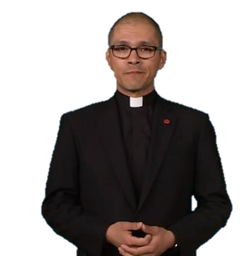
Escape
JESUIT
S
JESUIT: n. ONE WHO RESOLVES ETHICAL PROBLEMS (CASUIST/S)
Notes:
CASUIST/S, CASUISTIC, CASUISTICAL, CASUISTICALLY, CAUSISTRY, CAUSISTRIES
Shift + F5 to return to full screen

Slide 82
F J L L O O
ONE WORD

Slide 83
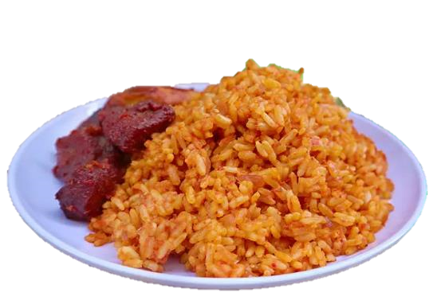
JOLLOF
S
JOLLOF: n. A WEST AFRICAN RICE DISH
(WGPO/WOW24 doesn’t accept the –S)

Slide 84
A A A K K n
ONE WORD

Slide 85
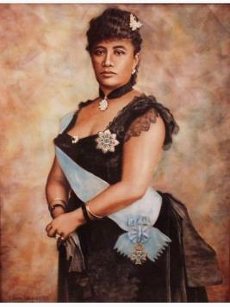
KANAKA
S
KANAKA: n. A NATIVE HAWAIIAN

Slide 86
A E K R T Y
ONE WORD

Slide 87
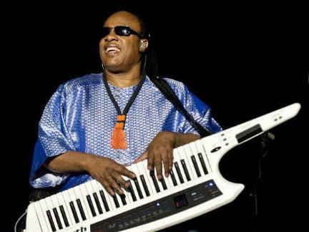
KEYTAR
S
KEYTAR: n. A KEYBOARD SLUNG OVER THE SHOULDERS, LIKE A GUITAR

Slide 88
A F H I K R
ONE WORD

Slide 89
KHARIF
S
KHARIF: n. A SOUTH ASIAN FALL HARVEST

Slide 90
I K O P P T
ONE WORD

Slide 91
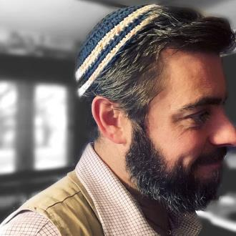
KIPPOT
S
KIPPOT: n. A JEWISH SKULLCAP (YARMULKE/S, KIPPA/S, KIPPAH/S)
also
YALMALKA/S
YAMULKA/S
YARMULKA/S
YARMELKE/S

Slide 92
A K M O R T
ONE WORD

Slide 93
KRATOM
S
KRATOM: n. AN HERBAL MEDICINE
(WGPO/WOW24 doesn’t accept the –S)

Slide 94
A E E F L R
ONE WORD

Slide 95
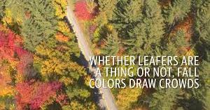
LEAFER
S
LEAFER: n. A TOURIST INTERESTED IN FALL FOLIAGE

Slide 96
D E I L O P
THREE WORDS

Slide 97
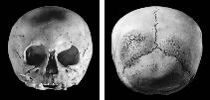
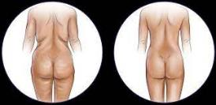
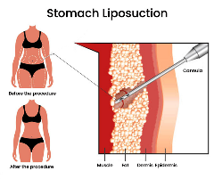
You could play
DIPOLE
DIPLOE
S
OR
S
DIPOLE: n. A PAIR OF EQUAL & OPPOSITE ELECTRIC CHARGES (adj. DIPOLAR)
DIPLOE: n. A BONY TISSUE OF THE CRANIUM
But you could play:
LIPOED
LIPOED: v. PERFORMED LIPOSUCTION (LIPO, LIPOS, LIPOING)

Slide 98
E E L S S U
ONE WORD

Slide 99
LUESES
LUESES: NWL23 pl. of LUES, SYPHILIS

Slide 100
A E K M N S
ONE WORD

Slide 101
MASKNE
S
MASKNE: n. A RASH CAUSED BY WEARING A MASK
(WGPO/WOW24 doesn’t accept the –S)

Slide 102
A A C H M T
ONE WORD

Slide 103
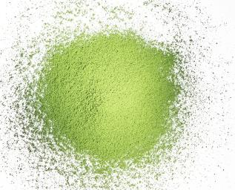
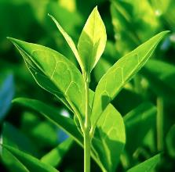
_
MATCHA
S
MATCHA: n. A POWDER MADE FROM GREEN TEA LEAVES

Slide 104
E E M P T U
ONE WORD

Slide 105
MEETUP
S
MEETUP: n. A MEETING, AN ASSEMBLY

Slide 106
D D E I M R
ONE WORD

Slide 107
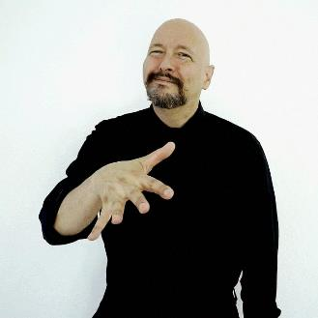
MIDDER
MIDDER: adj. MORE MID, NEITHER GREAT OR TERRIBLE (MIDDEST)

Slide 108
D D D E M O
ONE WORD

Slide 109
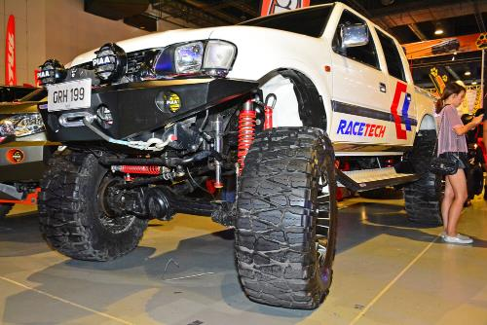
MODDED
MODDED: v. MADE AN AFTERMARKET MODIFICATION (MOD, MODS, MODDING)

Slide 110
D D E M O R
ONE WORD

Slide 111
_
MODDER
S
MODDER: 1) n. ONE WHO MADE AN AFTERMARKET MODIFICATION (pl. MODDERS)
2) adj. MORE MOD, HIP (MOD, MODDER, MODDEST)
Also v. TO MAKE AN AFTERMARKET MODIFICATION (MOD, MODS, MODDED, MODDING)

Slide 112
C E I N N O
TWO WORDS

Slide 113
Why play
CONINE
_
S
CONINE: n. A POISONOUS ALKALOID
(also CONIN/S & CONIINE/S)
when you could play:
NEONIC
S
NEONIC: n. AN INSECTICIDE

Slide 114
E E N S S W
ONE WORD

Slide 115
NEWSES
NEWSES: NWL23 pl. of NEWS, A REPORT ABOUT A RECENT EVENT OF INTEREST

Slide 116
B E I N O O
ONE WORD

Slide 117
NOOBIE
S
NOOBIE: n. A NEWCOMER, A NEWBIE, A NOOB
Bingo?
Can’t 4 play?
Is that a word?
Clock??

Slide 118
E I K N O O
ONE WORD

Slide 119
NOOKIE
S
NOOKIE: n. SEXUAL INTERCOURSE
(also sing. NOOKY, both with pl. NOOKIES)
nookie

Slide 120
E E I N O S
TWO WORDS

Slide 121
Why play
EOSINE
_
S
EOSINE: n. A RED DYE
(pl. EOSINES and also EOSIN/S with adj. EOSINIC))
when you could play:
ONESIE
S
ONESIE: n. A TYPE OF ONE-PIECE GARMENT

Slide 122
A K O S T U
TWO WORDS

Slide 123
Why play
OUTASK
S
OUTASK: v. TO SURPASS IN ASKING
(OUTASKS, OUTASKED, OUTASKING)
when you could play:
OTAKUS
_
OTAKUS: pl. of OTAKU, A YOUNG PERSON IN JAPAN WHO IS HIGHLY SKILLED IN COMPUTER TECHNOLOGY

Slide 124
C E N O R U
TWO WORDS
JUST 1 WORD

Slide 125
Why play
CONURE
S
CONURE: n. A TROPICAL AMERICAN PARAKEET
(pl. CONURES)
“THESE TWO CONURES ARE ONLY 11 OUNCERS.”
So maybe not play:
BP
OUNCER
_
S
OUNCES
OUNCER: NWL23 n. SOMETHING THAT WEIGHS A SPECIFIED NUMBER OF OUNCES

Slide 126
A G L L O X
ONE WORD

Slide 127
OXGALL
S
OXGALL: n. THE BILE OF AN OX
(WGPO/WOW24 doesn’t accept the –S)
I mean…I know what I use it for…but jeez.

Slide 128
A E O L P S
TWO WORDS

Slide 129
Why play
ASLOPE
_
ASLOPE: adj. SLOPING
when you could play:
PALEOS
_
PALEOS: pl. of PALEO, A DIET INSPIRED BY THE PALEOLITHIC ERA

Slide 130
A E E P P L
ONE WORD

Slide 131
PEEPAL
S
PEEPAL: n. A FIG TREE OF INDIA (also PIPAL/S & PEEPUL/S)

Slide 132
E I M M O P
ONE WORD

Slide 133
POMMIE
S
POMMIE: n. A BRITISH PERSON (also POMMY)
I can tell that they think I’m not British

Slide 134
D E N O P R
THREE WORDS

Slide 135
You could play
PERNOD
PONDER
S
OR
S
PERNOD: n. A TRADEMARKED BEVERAGE FROM FRANCE
PONDER: v. TO CONSIDER DEEPLY AND THOROUGHLY (-ED, -ING)
BUT you could play:
APRONED: v. TO PROVIDE WITH AN APRON (APRON, APRONS, APRONING)
PRONED
A
_
PRONED: v. TO MAKE PRONE, LYING FACE DOWN (PRONE, PRONES, PRONED, PRONING)

Slide 136
D E K N P U
ONE WORD

Slide 137
PUNKED
S
SPUNKED: v. BEGAN TO BURN (SPUNK, SPUNKS, SPUNKING)
PUNKED: v. DECEIVED (PUNK, PUNKS, PUNKED, PUNKING)
“These are not actually eye drops! I think I’ve been…

Slide 138
A E M N R S
THREE WORDS
ONLY 2 WORDS

Slide 139
You could play
NAMERS
_
REMANS
_
OR
NAMERS: pl. of NAMER, ONE THAT NAMES
REMANS: v. FURNISHES WITH A FRESH SUPPLY OF MEN
BUT maybe you shouldn’t play:
_
RAMENS
_
RAMENS: NWL23 pl. of n. RAMEN, A NOODLE SERVED IN A BROTH
(WGPO/WOW24 doesn’t accept the –S)

Slide 140
E O P R S T
EIGHT WORDS

Slide 141
You could play
POSTER
N
REPOTS
_
S
_
_
RESPOT
TROPES
_
_
PRESTO
_
_
S
STOPER
S
PRESTO: n. A RAPID MUSICAL PASSAGE
OR
STOPER: n. AN ORE EXCAVATOR
TOPERS
_
AGAIN?
TOPERS: pl. of TOPER, ONE THAT DRINKS TO EXCESS
BUT you could play:
REPOST
_
S
REPOST: v. TO POST AGAIN

Slide 142
C E O N R T
TWO WORDS

Slide 143
Why play
CORNET
S
T
CORNET: n. A TRUMPET-LIKE INSTRUMENT
also CORNETT/S, CORNETTI, CORNETTO/S
when you could play:
RETCON
S
RETCON: v. TO CHANGE A STORY BY REINTERPRETING ITS PAST, RETROACTIVE CONTINUITY (RETCONNED, RETCONNING)

Slide 144
E o r s u x
ONE WORD

Slide 145
ROUXES
ROUXES: NWL23 pl. of ROUX, A MIXTURE OF BUTTER AND FLOUR

Slide 146
A E L M S U
TWO WORDS

Slide 147
Why play
ULEMAS
_
ULEMAS: pl. of ULEMA, A MUSLIM SCHOLAR
when you could play:
SALUME
SALUME n. AN ITALIAN PREPARATION OF SALTED AND CURED MEAT
(pl. SALUMI, also SALAMI/S)

Slide 148
A I L M S U
TWO WORDS

Slide 149
Why play
MIAULS
_
And you can conjugate:
MIAOU
MIAOW
MEOW
MIAULS: v. MEOWS
Miaul
(MIAUL, MIAULS, MIAULED, MIAULING)
when you could play:
SALUMI
SALUMI: the only pl. of SALUME, AN ITALIAN PREPARATION OF SALTED AND CURED MEAT
(also SALAMI/S)

Slide 150
D E E S T X
ONE WORD

Slide 151
SEXTED
SEXTED: v. SENT AN EXPLICIT TEXT MESSAGE
(SEXT, SEXTS, SEXTED, SEXTING, SEXTINGS)

Slide 152
A H I K S S
ONE WORD

Slide 153
SHIKSA
S
SHIKSA: n. A JEWISH FEMALE WHO DOES NOT OBSERVE JEWISH PRECEPTS (also SHICKSA/S, SHIKSE/S, and SHIKSEH/S)

Slide 154
E H I K S S
TWO WORDS

Slide 155
Why play
SHEIKS
_
SHEIKS: pl. of SHEIK, AN ARAB CHIEF (also SHEIKH/S
when you could play:
SHIKSE
S
SHIKSE: A JEWISH FEMALE WHO DOES NOT OBSERVE JEWISH PRECEPTS

Slide 156
D E H I S V
ONE WORD

Slide 157
_
SHIVED
SHIVED: v. STABBED WITH AN IMPROVISED KNIFE
(SHIV, SHIVS, SHIVED, SHIVVED, SHIVING, SHIVVING)
SHIVE: n. A THIN FRAGMENT (pl. SHIVES)

Slide 158
E I L O S S
ONE WORD

Slide 159
SILOES
SILOES: v. STORES IN A TALL, CYLINDRICAL STRUCTURE CALLED A SILO (both SILOS and SILOES, SILOED, SILOING)

Slide 160
E E K S Y Z
ONE WORD

Slide 161
SKEEZY
SKEEZY: adj. REPULSIVE (SKEEZIER, SKEEZIEST)

Slide 162
E M N T U U
ONE WORD

Slide 163
D
UNMUTE
S
UNMUTE: v. TO STOP MUTING (UNMUTING)

Slide 164
A I N P R U
ONE WORD

Slide 165
UNPAIR
S
UNPAIR: v. TO CAUSE TO STOP BEING PAIRED
(UNPAIRED, UNPAIRING)

Slide 166
B D E E R V
ONE WORD

Slide 167
VERBED
O
VERBED: v. TO USE A NOUN AS A GRAMMATICAL PREDICATE
(VERB, VERBS, VERBED, VERBING)
FRIEND (n.) FRIENDED (v.)

Slide 168
B G I I N V
ONE WORD

Slide 169
VIBING
VIBING: v. BEING COMPATIBLE
(VIBE, VIBES, VIBED, VIBING)

Slide 170
A E I L R W
TWO WORDS
ONLY 1 WORD

Slide 171
Why play
WAILER
S
WAILER: n. ONE THAT WAILS, UTTERS A LONG MOURNFUL CRY
So maybe you shouldn’t play:
WALIER
_
WALIER: adj. MORE WALY, VISUALLY PLEASING (WALIEST)
WALIE: adj. STURDY
Notes:
Both NWL23 and WOW24 accept WALY. WOW24 does not accept it as an adjective that compares.

Slide 172
A D L O U W
ONE WORD

Slide 173
_
WOULDA
WOULDA: v. WOULD HAVE
ALL THREE WORDS NOW GOOD IN SCRABBLE!

Slide 174
A E E H W Y
ONE WORD

Slide 175
YEEHAW
YEEHAW: interj. EXPRESSING DELIGHT

Slide 176
A A A R T Z
ONE WORD

Slide 177
ZAATAR
S
ZAATAR: n. A MIDDLE EASTERN SPICE BLEND
(WGPO/WOW24 doesn’t recognize the rear –S)

Slide 178
D E K N O Z
TWO WORDS

Slide 179
Why play
ZONKED
ZONKED: v. STUPEFIED (ZONK, ZONKS, ZONKING)
when you could play:
ZEDONK
S
ZEDONK: n. THE OFFSPRING OF A MALE DONKEY & FEMALE ZEBRA

Slide 180
E K N O Y Z
ONE WORD

Slide 181
ZONKEY
S
ZONKEY: n. THE OFFSPRING OF A MALE ZEBRA & FEMALE DONKEY

Slide 182
D E L O O Z
ONE WORD

Slide 183
ZOODLE
S
ZOODLE: n. A NOODLE MADE FROM ZUCCHINI

Slide 184
E M O O R Z
ONE WORD

Slide 185
ZOOMER
S
ZOOMER: n. A PERSON BORN IN THE LATE 1990’S OR EARLY 2000’S

Slide 186
That should do it for the new “sixes” in NWL23
with attention to words not recognized by WGPO’s WOW24 word list.
Suggestions? Criticisms? Please email Bill at williamrsnoddy@gmail.com

Slide 187
Hopefully now you can make “sense of the sixes.”
“I see new words.”

