Slide 1
NWL 23 “NEW FIVES”

Slide 2
FIVES
IF the above does NOT show numbered Scrabble tiles, then
make sure you are viewing your downloaded version in PowerPoint or Keynote
Use PowerPoint or Keynote in FULL SCREEN “SLIDE SHOW” mode on your LAPTOP or DESKTOP for best results
When you see the “ESCAPE KEY” ICON check speaker notes for additional information by hitting the escape key
Notes:
.

Slide 3
These are the new FIVES from NWL2023:
The slide show will concentrate on the truly “new fives” and not plurals of new threes & fours like DOXES and ZUKES

Slide 4
ABYED, BOTOX, BROEY, BUBBA, CELLY, CHAGA, CHOLA, CHOLO
CONVO, CORYS, COSMO, COVID, DUKKA, DURAG, EELED, EFFED, FAVER,
FINNA, FIREE, FUGLY, GEPIK, GLAMP, GONNA, GOTTA,
GOYIM, HAOLE, HUNDO, HYGGE, IFTAR, INCEL, INNIE, INROS, INSPO, INTEL JANKY, JIAOS, KAMIS, KORIS, LAGGY, NAPED, NATTO, NDUJA, NOOKY, OUTIE,
PALEO, PANKO, POMMY, POOFY, QUESO, RANDO, SHART, SITCH, SPAZZ,
SPORK, SWOLE, THWAP, TRYNA, TYINS, UNSUB, VACAY, VIBED, WAGYU, WANNA

Slide 5
A B D E Y
THREE WORDS

Slide 6
YOU COULD PLAY
_
BAYED
BEADY
OR
OR MAYBE DRAW A CHALLENGE WITH:
ABY
ABYS
ABYE
ABYES
ABYED
ABYING
ABYEING
ABOUGHT
_
ABYED
ABYED: v. TO PAY THE PENALTY FOR

Slide 7
B O O T X
ONE WORD

Slide 8
BOTOX
BOTOX: v. TO INJECT BOTULINUM TOXIN (BOTOXED, BOTOXES, BOTOXING)

Slide 9
B E R O Y
ONE WORD

Slide 10
BROEY
BROEY: adj. RESEMBLING A BROTHER (BRO, BROS, BROIER, BROIEST)

Slide 11
A B B B U
ONE WORD

Slide 12
BUBBA
S
BUBBA: n. BROTHER

Slide 13
C e l l y
ONE WORD

Slide 14
_
celly
CELLY: n. short for CELLMATE (also singular CELLIE, both pl. CELLIES)
Notes:
.

Slide 15
A A C G H
ONE WORD

Slide 16
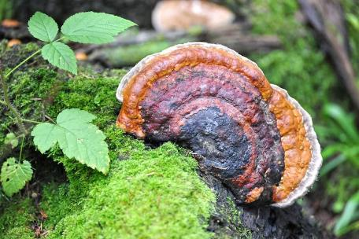
CHAGA
S
CHAGA: n. AN EDIBLE MUSROOM

Slide 17
A C H L O
TWO WORDS

Slide 18
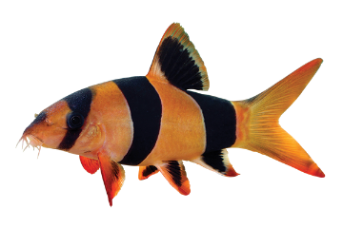
YOU COULD PLAY
LOACH
LOACH: A FRESHWATER FISH (pl. LOACHES):
OR MAYBE DRAW A CHALLENGE WITH:
CHOLA
S
CHOLA: n. A TEENAGE GIRL WHO ASSOCIATES CLOSELY WITH A GANG

Slide 19
C H L O O
ONE WORD

Slide 20
HOLO: n. A HOLOGRAM
_
CHOLO
S
CHOLO: n. A YOUNG MEXICAN-AMERICAN GANG MEMBER

Slide 21
C N O O V
ONE WORD

Slide 22
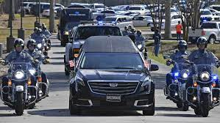
S
CONVO
Y
CONVO: n. A CONVERSATION
CONVOY: v. ESCORT (CONVOYS, CONVOYED, CONVOYING)

Slide 23
C O R S Y
ONE WORD

Slide 24
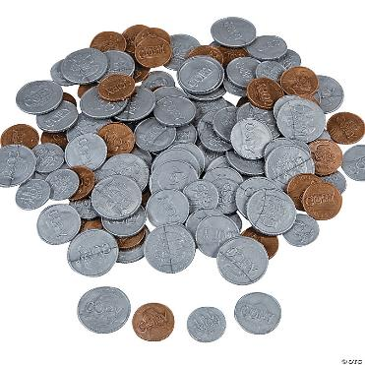
CORYS
_
CORYS: pl. of CORY, A FORMER MONEY OF GUINEA

Slide 25
C M O O S
ONE WORD

Slide 26
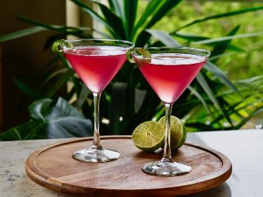
COSMO
S
COSMO: n. A TYPE OF COCKTAIL, COSMOPOLITAN
COSMOS: n. AN ORDERLY UNIVERSE
(pl. COSMOSES)

Slide 27
C D I O V
ONE WORD

Slide 28
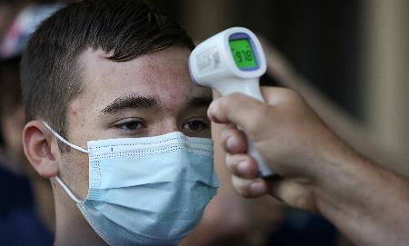
COVID
S
COVID: n. ILLNESS CAUSED BY CORONOVIRUS (pl. COVIDS)

Slide 29
A D K K U
ONE WORD

Slide 30
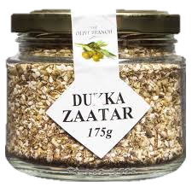
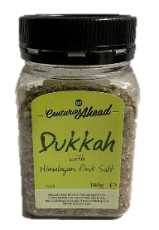
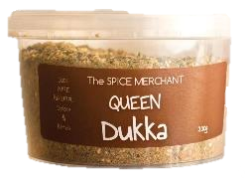
H
DUKKA
S
DUKKA: n. AN EGYPTIAN CONDIMENT
(also DUKKAH/S)

Slide 31
A D G R U
TWO WORDS

Slide 32
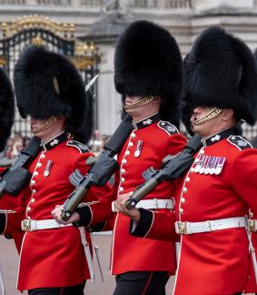
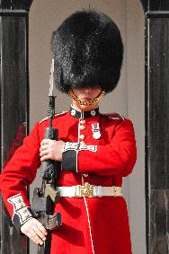
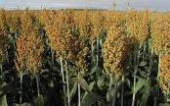
YOU COULD PLAY
GUARD
_
GUAR: n. A LEGUME
S
GUARD: v. PROTECT (adv. GUARDEDLY, n. GUARDER/S)
OR MAYBE DRAW A CHALLENGE WITH:
DURAG
_
S
DURAG: n. A BANDANA
DURA: n. A CEREAL GRAIN
(DURRA/S)

Slide 33
D E E E L
ONE WORD

Slide 34
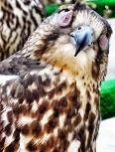
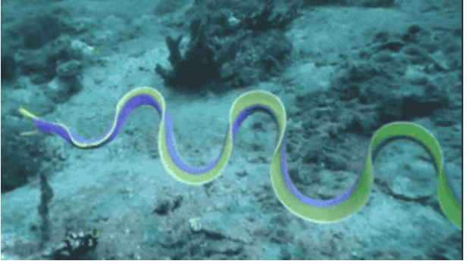
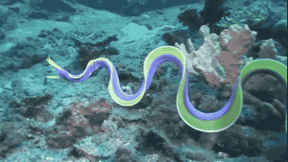
HKPRS
EELED
SEELED: v. TO SEW A FALCON’S EYES SHUT DURING TRAINING
EELED: v. TO MOVE SINUOUSLY (EEL, EELS, EELING)

Slide 35
D E E F F
ONE WORD

Slide 36
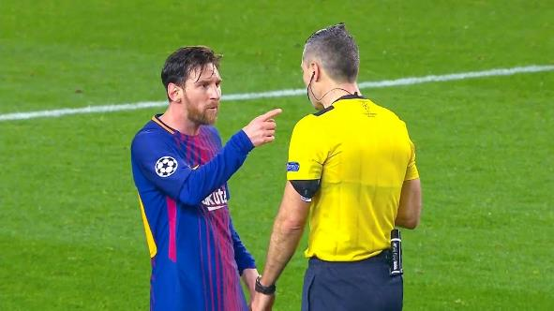
EFFED
R
EFFED: v. AN OFFENSIVE WORD
(also EFFING)
YOU EFFED UP, REF!
NO EFFING WAY!

Slide 37
A E F R V
ONE WORD

Slide 38
_
_
FAVER
FAVER: NWL23 adj. MORE FAVORITE (FAVE, FAVEST)

Slide 39
A F I N N
ONE WORD

Slide 40
FINNA
N
FINNA: v. “FIXING TO”
FINNAN: SMOKED HADDOCK (pl. FINNANS)
NWL 23 “NEW FIVES”
“I FINNA LEARN SOME NEW FIVES”

Slide 41
E E F I R
ONE WORD

Slide 42
FIREE
S
FIREE: n. ONE WHO HAS BEEN FIRED

Slide 43
F G L U Y
TWO WORDS

Slide 44
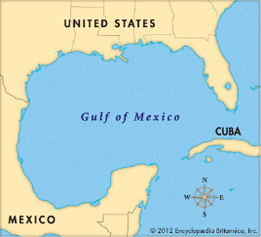
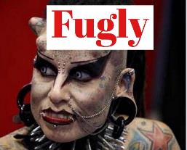
YOU COULD PLAY
GULFY
_
GULFY: adj. FULL OF WHIRLPOOLS
(GULFIER, GULFIEST)
OR MAYBE DRAW A CHALLENGE WITH:
FUGLY
_
FUGLY: adj. FRIGGIN’ UGLY (FUGLIER, FUGLIEST)

Slide 45
E G I K P
ONE WORD

Slide 46
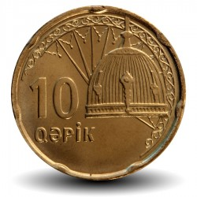
GEPIK
S
GEPIK: n. ONE HUNDRETH OF A MANAT, A MONETARY UNIT OF AZERBAIJAN (synonym GOPIK/S)

Slide 47
G I M O Y
ONE WORD

Slide 48
GOYIM
GOYIM: one pl. of GOY, A NON-JEWISH PERSON (also pl. GOYS)

Slide 49
A E H L O
ONE WORD

Slide 50
HAOLE
S
HAOLE: n. ONE WHO IS NOT A NATIVE HAWAIIAN

Slide 51
D H N O U
TWO WORDS

Slide 52
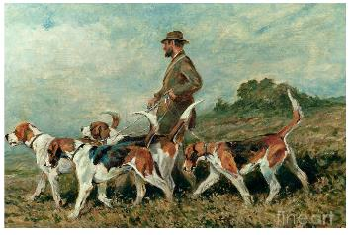
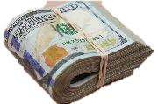
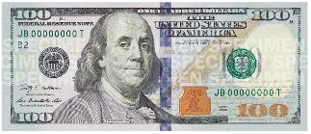
YOU COULD PLAY
HOUND
S
HOUND: v. TO PURSUE RELENTLESSLY
(HOUNDS, HOUNDED, HOUNDING)
OR MAYBE DRAW A CHALLENGE WITH:
HUNDO
_
S
HUNDO: n. A HUNDRED

Slide 53
E G G H Y
ONE WORD

Slide 54
HYGGE
S
HYGGE: n. A COMFORTING COZY QUALITY

Slide 55
A F I R T
TWO WORDS

Slide 56
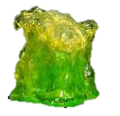
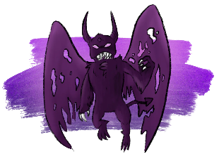
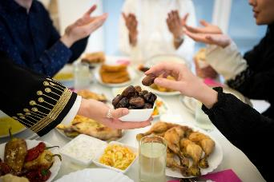
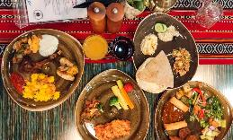
YOU COULD PLAY
AFRIT
_
FRIT: v. TO FUSE INTO A JELLY-LIKE SUBSTANCE
(FRITS, FRITTED, FRITTING)
S
AFRIT: n. AN EVIL SPIRIT (also AFREET/S)
OR MAYBE DRAW A CHALLENGE WITH:
IFTAR
S
IFTAR: n. A MEAL THAT BREAKS A FAST DURING RAMADAN

Slide 57
C E I L N
TWO WORDS

Slide 58
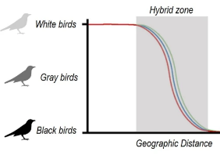
YOU COULD PLAY
CLINE
_
S
CLINE: n. A SERIES OF CHANGES WITHIN A SPECIES
OR MAYBE DRAW A CHALLENGE WITH:
INCEL
S
INCEL: n. A MAN WHO RESENTS BEING CELIBATE (INVOLUNTARY CELIBATE)

Slide 59
E I I N N
ONE WORD

Slide 60
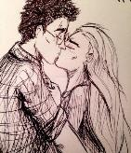
INNIE
H
S
INNIE: n. A CONCAVE NAVEL (Yes, OUTIE/S now good as well)
HINNIE: n.
A DARLING,
A SWEETHEART
Also HINNY: v. TO WHINNY (HINNIES, HINNIED, HINNYING)

Slide 61
I N O R S
SIX WORDS!

Slide 62
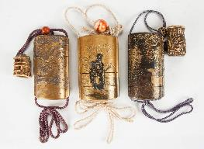
YOU COULD PLAY
ORNIS
_
NORIS
ORNIS: n. REGIONAL BIRD LIFE (pl. ORNITHES)
NORIS: pl. of NORI, A SHEET OF DRIED SEAWEED
_
ROSIN
NOIRS
S
NOIRS: pl. of NOIR, BLEAK CRIME FICTION
ROSIN: v. TO TREAT WITH ROSIN (also RESIN)
_
ROSINS ROSINED ROSINING
IRONS
G
BUT WHY NOT DRAW A CHALLENGE WITH:
GIRON: n. A HERALDIC DESIGN (also GYRON/S)
INROS
_
INROS: NWL23 pl. of INRO, A JAPANESE ORNAMENTAL CONTAINER

Slide 63
I N O P S
THREE WORDS

Slide 64
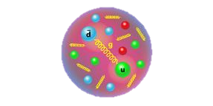
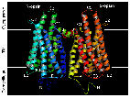
YOU COULD PLAY
_
_
OPSIN
PIONS
S
OR
OPSIN: n. A TYPE OF PROTEIN
PIONS: pl. of PION, A SUBATOMIC PARTICLE
OR MAYBE DRAW A CHALLENGE WITH:
INSPO
S
INSPO: n. AN INSPIRATION
Notes:
.

Slide 65
E I L N T
THREE WORDS

Slide 66
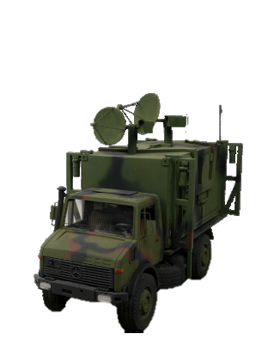
YOU COULD PLAY
_
ELINT
INLET
S
OR
S
ELINT: n. THE GATHERING OF INTELLIGENCE WITH ELECTRONICS
INLET: v! TO INSERT (INLETS, INLETTING, but no –ED form!)
OR MAYBE DRAW A CHALLENGE WITH:
INTEL
L
S
LINTEL: n. A SUPPORTING BEAM
INTEL: n. INTELLIGENCE
Notes:
INLETTING: The process of carving out recesses in wooden stocks with precision, using gouges, chisels and scrapers to accept the steel components of a firearm.

Slide 67
A G L M P
ONE WORD

Slide 68
GLAMP
_
_
S
GLAM: adj. (GLAMMER, GLAMMEST) also v. GLAMS, GLAMMED, GLAMMING)
GLAMP: v. TO CAMP IN LUXURY (GLAMPED, GLAMPING, GLAMPER/S)
Notes:
.

Slide 69
A G N N O
ONE WORD

Slide 70
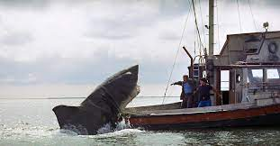
GONNA
GONNA: v. GOING TO

Slide 71
A G O T T
ONE WORD

Slide 72
GOTTA
GOTTA: v. GOT TO

Slide 73
A J K N Y
ONE WORD

Slide 74
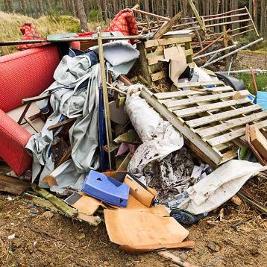
JANKY
JANKY: adj. JUNKY, WORTHLESS (JANKIER, JANKIEST)

Slide 75
A I J O S
ONE WORD

Slide 76
JIAOS
_
JIAOS: NWL23 pl. of JIAO, A MONETARY UNIT OF CHINA (also CHIAO- with no S plural)

Slide 77
A I k m s
TWO WORDS

Slide 78
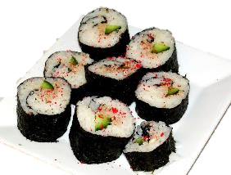
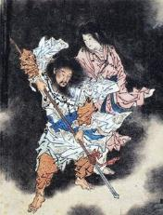
YOU COULD PLAY
MAKIS
_
MAKIS: pl. of MAKI, SUSHI ROLLED IN NORI (SEAWEED)
OR MAYBE DRAW A CHALLENGE WITH:
KAMIS
_
_
AMIS: pl. of AMI, A FRIEND
KAMIS: NWL23 pl. of KAMI,
A SACRED POWER OR FORCE

Slide 79
I K O R S
ONE WORD

Slide 80
KORIS
_
KORIS: pl. of KORI, A MONETARY UNIT OF GUINEA (also CAURI/S)

Slide 81
A G G L Y
ONE WORD

Slide 82
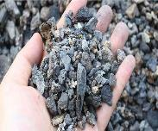
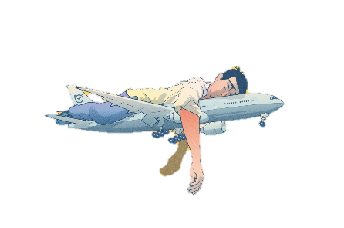
F
LAGGY
S
LAGGY: adj. AFFECTED BY LAG, (LAGGIER, LAGGIEST)
FLAGGY: adj. DROOPING (FLAGGIER, FLAGGIEST)
SLAGGY: adj. RESEMBLING SLAG (SLAGGIER, SLAGGIEST)

Slide 83
A D E N P
TWO WORDS

Slide 84
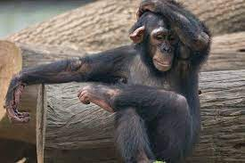
YOU COULD PLAY
PANED
_
PANED: adj. HAVING PANES
OR MAYBE DRAW A CHALLENGE WITH:
NAPED
_
_
APED: v. MIMICKED
NAPED: adj. HAVING A NAPE, THE BACK OF THE NECK

Slide 85
A N O T T
TWO WORDS

Slide 86
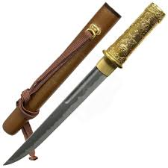
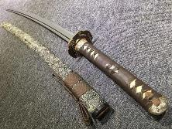
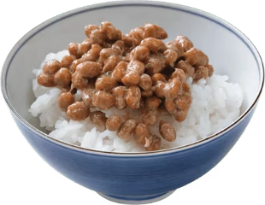
YOU COULD PLAY
TANTO
S
TANTO: A SHORT JAPANESE SWORD
OR MAYBE DRAW A CHALLENGE WITH:
NATTO
A
S
NATTO: FERMENTED SOYBEANS
ANATTO: YELLOW-RED DYE (also ANNATTO/S)

Slide 87
A D J N U
ONE WORD

Slide 88
NDUJA
S
NDUJA: A SPICY PORK SAUSAGE

Slide 89
K N O O Y
ONE WORD

Slide 90
NOOKY
_
NOOK: A CORNER, AS IN A ROOM
NOOKY: SEXUAL INTERCOURSE (also sing. NOOKIE, both with pl. NOOKIES)

Slide 91
E I O T U
ONE WORD

Slide 92
OUTIE
S
OUTIE: A CONVEX NAVEL (Yes, INNIE/S now good as well)

Slide 93
A E L O P
ONE WORD

Slide 94
PALEO
_
S
PALEO: A PALEOLITHIC DIET

Slide 95
A K N O P
ONE WORD

Slide 96
PANKO
NOTE: DOES NOT TAKE A REAR S!
PANKO: BREAD CRUMBS USED FOR COATING FOOD

Slide 97
M M O P Y
ONE WORD

Slide 98
POMMY
POMMY: n. A BRITISH PERSON
(also POMMIE, both with pl. POMMIES)
Notes:
.

Slide 99
F O O P Y
ONE WORD

Slide 100
POOFY
_
POOFY: adj. PUFFY (POOFIER, POOFIEST)
POOF: interj. USED TO INDICATE AN INSTANTANEOUS OCCURRENCE (no -S)

Slide 101
E o q s u
ONE WORD

Slide 102
QUESO
S
QUESO: n. MELTED CHEESE SAUCE WITH CHILI PEPPERS

Slide 103
A D N O R
FOUR WORDS

Slide 104
YOU COULD PLAY
RADON
ANDRO
S
S
RADON: n. A RADIOACTIVE ELEMENT
ANDRO: n. A STEROID SEX HORMONE
OR
ADORN
S
BUT WHY NOT DRAW A CHALLENGE WITH:
RANDO
M
_
S
RANDO: n. A RANDOM PERSON
RAND: n. A STRIP OF LEATHER ON THE HEEL OF A SHOE

Slide 105
A H R S T
FOUR WORDS

Slide 106
YOU COULD PLAY
C
HARTS
TAHRS
_
_
_
S
HARTS: pl. of HART, A MALE DEER
OR
TAHRS: pl. of TAHR, A GOAT-LIKE MAMMAL
TRASH
_
Y
BUT WHY NOT DRAW A CHALLENGE WITH:
SHART
_
S
SHART: v. EXPEL FECES WITH FLATUS
(SHART, SHARTS, SHARTED, SHARTING)

Slide 107
C H I S T
THREE WORDS

Slide 108
YOU COULD PLAY
_
_
CHITS
STICH
OR
S
CHITS: pl. of CHIT, A SHORT LETTER
STICH: n. A LINE OF POETRY
OR MAYBE DRAW A CHALLENGE WITH:
_
SITCH
SITCH: n. SITUATION (pl. SITCHES)

Slide 109
A P S Z Z
ONE WORD

Slide 110
SPAZZ
_
SPAZZ: n. A KLUTZ, A CLUMSY PERSON (pl. SPAZZES)
SPAZ
SPAZZ
SPAZZES
SPAZZED
SPAZZING

Slide 111
K O P R S
TWO WORDS

Slide 112
YOU COULD PLAY
PORKS
_
S
PORKS: v. EATS RAVENOUSLY (PORK, PORKED, PORKING)
OR MAYBE DRAW A CHALLENGE WITH:
SPORK
_
S
SPORK: n. COMBINATION SPOON & FORK

Slide 113
E L O S W
THREE WORDS

Slide 114
YOU COULD PLAY
_
_
_
OWSE: n. OX (pl. OWSEN)
LOWES
_
T
LOWSE
OR
LOWES: v. BLAZES (LOWE, LOWED, LOWING)
LOWSE: adj. LOOSE
OR MAYBE DRAW A CHALLENGE WITH:
SWOLE
R
SWOLE: adj. MARKEDLY MUSCULAR (SWOLER, SWOLEST)

Slide 115
A H P T W
ONE WORD

Slide 116
THWAP
S
THWAP: v. TO SLAP NOISILY (THWAPPED, THWAPPING)

Slide 117
A N R T Y
ONE WORD

Slide 118
TRYNA
TRYNA: v. TRYING TO

Slide 119
I N S T Y
TWO WORDS

Slide 120
YOU COULD PLAY
TIYNS
_
TIYNS: pl. of TIYN, A MONETARY UNIT IN KAZAKHSTAN
(also TIYINS)
OR MAYBE DRAW A CHALLENGE WITH:
TYINS
_
_
YINS: pl. of YIN, FEMININE CHINESE COSMOLOGY
TYINS: pl. of TYIN, A MONETARY UNIT IN KAZAKHSTAN

Slide 121
B N S U U
ONE WORD

Slide 122
UNSUB
S
UNSUB: n. AN UNIDENTIFIED CRIMINAL SUSPECT

Slide 123
A A C V Y
ONE WORD

Slide 124
VACAY
S
VACAY: n. A VACATION

Slide 125
B D E I V
ONE WORD

Slide 126
_
VIBED
VIBED: v. WAS COMPATIBLE (VIBE, VIBED, VIBES, VIBING)

Slide 127
A G U W Y
ONE WORD

Slide 128
WAGYU
WAGYU: n. A JAPANESE STRAIN OF BEEF CATTLE (no rear –S)

Slide 129
A a n n w
ONE WORD

Slide 130
WANNA
WANNA: v. WANT TO

Slide 131
Well, there they are…not that many. Some weird ones for sure!

Slide 132
THE END
Notes:
.

